Slide 1
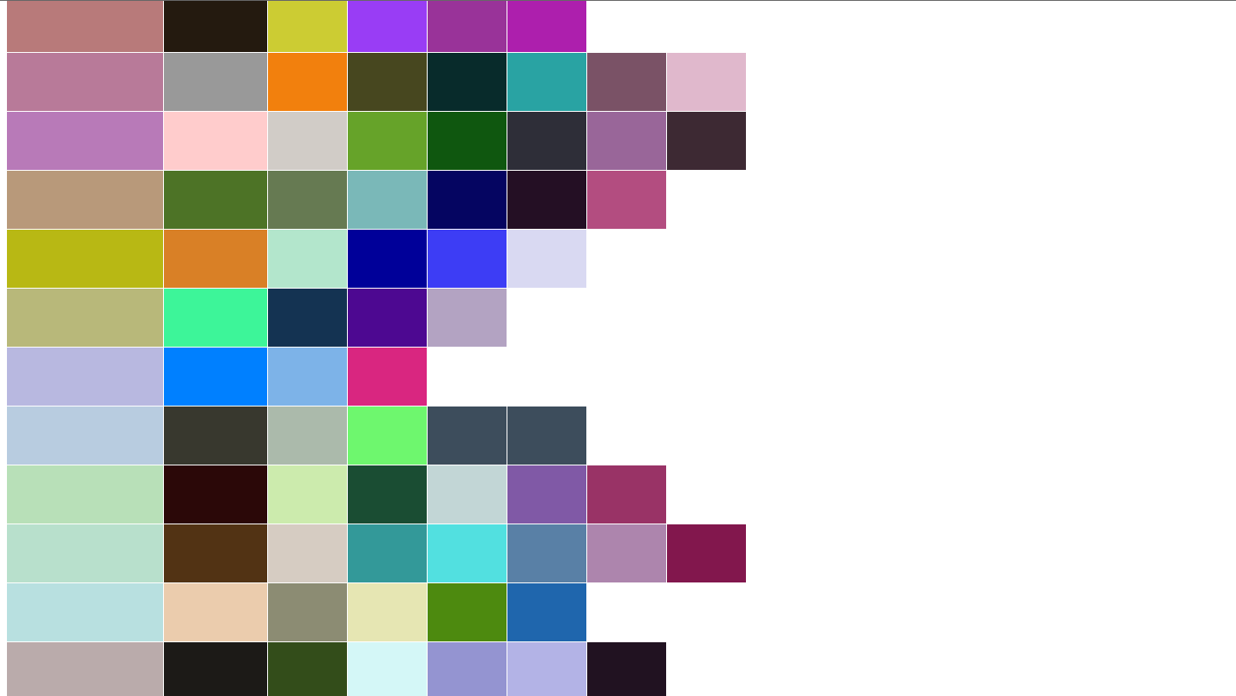
JuxtaPrism and Color Management
Lorrae Famiglietti
Spring 2012

Slide 2
Introduction
How do human perceive color?
People evaluate pairs of colors on the website
Users vote whether pairs go well together or not
Information useful for psychologists, marketers, graphic designers

Slide 3
Introduction
Color Theory
Color Scales
Color Schemes
Color Management
How color is displayed

Slide 4
Introduction
Color Schemes
JuxtaPrism uses two:
RGB
(Red, Green, Blue)
HSL
(Hue, Saturation, Brightness/Light)
Must convert from HSL -> RGB

Slide 5
Introduction
Color Management
List of colors to be displayed is already stored in database
Users vote on their own personal machines
JuxtaPrism does not control what hardware/software they use to take survey

Slide 6
Introduction
The problem:
“How can JuxtaPrism ensure that the data is accurate if users do not see the correct colors displayed?”

Slide 7
Introduction
The solution:
Ensure that everyone surveyed sees the exact color values

Slide 8
Introduction
Current data does not take this data into account
The way the website is currently designed does not offer a solution for this problem

Slide 9
Color Scales
Additive Color Scales
Ex: RGB
Subtractive Color Scales
Ex: CYMK
Cylindrical Coordinate Color Scales
Ex: HSL

Slide 10
Additive Color Scale
Combines primary values to make distinct colors
Additive reproduction
This property is important when trying to solve the color management problem

Slide 11
RGB
Additive color scale
Red, Green, Blue are the three primary colors
Based off the way the human eye was though to perceive color

Slide 12
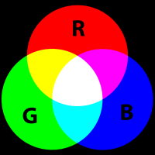
RGB
Color broken down into three primary components
Reconstructed to form a color

Slide 13
RGB
Benefit
Ease of use with HTML (website needs to look good)
Limitation
Relies on primary color values
Arbitrary

Slide 14
RGB Solutions
RGB standard
Instituted by the International Color Consortium (ICC)
sRGB
Ensures that colors are consistent across devices
Opt-In, though most manufacturers have opted in

Slide 15
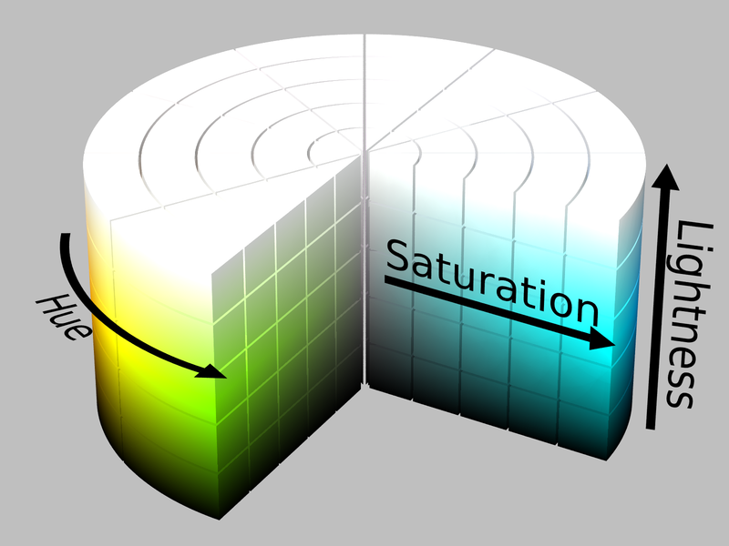
HSL
Cylindrical coordinate system
Similar to HSV (hue, saturation, value)
Hue range: [0, 360]
Saturation range: [0, 1]
Light range: [0, 1]

Slide 16
HSL
Can easily represent gradual shades and tints found in nature
Use regular intervals of the three parameters to get regular color sample
JuxtaPrism uses 30 degree increments from hue, 10% increments for light and saturation

Slide 17
HSL
Limitations
Multiple representations of white, black, and grey scale
Not all colors generated are totally unique
Does not represent the same thing as RGB
JuxtaPrism needs the colors in RGB to be displayed on the website

Slide 18
HSL and RGB together
Colors generated in HSL
RGB color values calculated
RGB value checked against database
If the value already exists, throw it out

Slide 19
Conversion Algorithm
If saturation is 0, then color is grey scale
Red, Green, Blue = light percentage
Hue doesn’t matter, does not change the color at all
2 Temp variables calculate the ratios of light and saturation
Used to determine the amount of overall color needed

Slide 20
Conversion Algorithm
The proportion variables, along with the color’s hue is passed to another function
Based on the amount of that hue present, the red, green, and blue values are assigned.

Slide 21
HSL and RGB
JuxtaPrism keeps color values for the HSL ad RGB scale
More parameters = more comparisons/analysis

Slide 22
Color Management
Means in which colors are portrayed accurately through media
Colors adjusted across devices to show the correct tones/hues
Ensures that images are reproduced true to the original

Slide 23
International Color Consortium (ICC)
Addresses the issue of color management
Created standard color profiles for hardware and software
sRGB
Optional for manufacturers

Slide 24
Color and the Human Eye
Representations of color attempt to reproduce the way humans see color
Color is result of a wavelength of light
Each color has a unique wavelength

Slide 25
Color and the Human Eye
Your eyes interpret wavelengths of light as color
Entirely personal experience
No guarantee what you see as “blue” is what I see as “blue”
Environment also changes the appearance of colors (well lit room vs. dark room)

Slide 26
Color and the Human Eye
Large and unknown variable
Cannot correct or prevent this issue from occurring
Nothing we can do about it

Slide 27
Color and Hardware
Original Image
HSL
Printer
CYMK
Hard Copy
Scanner
RGB
Exact image?

Slide 28
Color and Hardware
Every time a new device is used, that device changes the color values of an image
Every transfer involves estimations
Every device probably isn’t calibrated correctly

Slide 29
Color and Hardware
Different devices display color differently
Hopefully users are using ICC approved and calibrated devices
JuxtaPrism has no way of ensuring this

Slide 30
Color and Software
Different representations of color
Crayon example
Lukasz draws a picture using his 200 color Crayola crayon box (with built in sharpener!) and tells me to copy his picture exactly. I only have a Roseart 12 color crayon box. Even if I draw exactly the same lines as Lukasz does, our picture won’t be identical. ☹

Slide 31
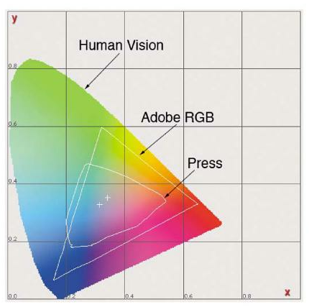
Color Gamuts
Devices and software are limited by their color gamuts.
Lukasz is drawing using the colors available to Adobe RGB, and I’m stuck with the printing press’s colors.

Slide 32
How this affects JuxtaPrism
Colors are rounded in the conversion algorithm
Not a problem – I just kept track of both
User’s web browser may not support the color that needs to be displayed

Slide 33
Existing solutions
ICC
International Color Consortium
Leave it to the ICC to manage color protocols

Slide 34
Existing Solutions
Calibrate Specific devices
Assume scanner is working good (probably is)
Print an image, scan it back in, let printer calibrate itself
Now printer is calibrated
Print a new image on calibrated printer, scan using (hopefully) calibrated scanner, adjust monitor accordingly
Spectrophotometer
Reads color values on screen, comes with software to calibrate monitor to standard

Slide 35
Existing Solutions
Default device profile
Use spectrophotometer to read current color profile
Calibrate device back to default

Slide 36

Solutions for JuxtaPrism

Slide 37
Why this won’t work
Color on left is control color
Color on right is adjusted by user to match left color
In the end, the color values are the same, so we get:
(255, 0, 0) = (255, 0, 0)
Color distance = 0

Slide 38
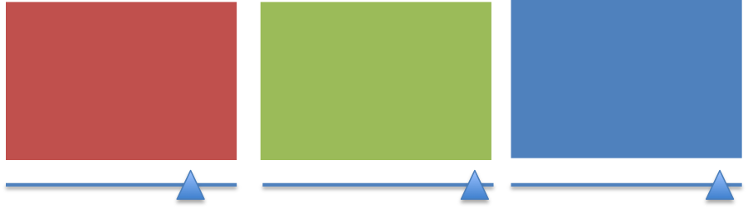
Color Distance, take 2

Slide 39
Color Distance, take 2
Ask users to set red, green, and blue to their true values
Use color distance to adjust output of website
Relies too much on user knowledge and opinion
Need unbiased third party

Slide 40
Controlled Environment
JuxtaPrism establishes a “survey center”
Every workspace has exact same computers
Every computer calibrated
Lighting for the room is always the same

Slide 41
Conclusion
For now:
Assume everyone’s computer is reasonably calibrated
Results subject to random error
In marketing and graphic design, this will be the case anyway
Best representation of what users are actually seeing

Slide 42
Questions?

