Slide 1




Articulated Technological Education Pathways (ATEP) www.Hofstra.edu/ATEP
WELCOME BILT MEMBERS
January 20, 2012
Business and Industry Leadership Team
Baltimore, Maryland

Slide 2

BILT Members ATEP Team Members
Kendall Starkweather (Chairperson), Executive Director, ITEEA
Sandy Clark, Editorial Director, Cengage Learning
Sulatha Dwarakanath, Nano Science Diagnostics
Charles Goodwin, Chair, NYS Technology Education Advisory Council
Michael Morton, Former CTE Director, Arlington, Virginia Public Schools
Scott Veibell, Manager, Technical Support, Cisco Systems
Bill Vitale, VP of Research and Development, Precision Elastomers
Cindy Weber, Superintendent of Schools, Durand Area Schools, Durand, MI.
Joyce Winterton, Senior Advisor for Education and Leadership Development at NASA Wallops Flight Facility
Ann Beheler (Co-PI), Convergence Technology Center, Dallas, TX
Anthony Gordon (Media Developer), Hofstra University, Saginaw, MI
Michael Hacker (PI), Hofstra University, Hempstead, NY
Deborah Hecht (Evaluator), Center for Advanced Study in Education
Linnea Fletcher (Co-PI), Bio-Link Center, Austin Community College, TX
Jim Kiggens (Media Developer), Sequoia Studios, Santa Barbara, CA
Brian Shmaefsky, Lone Star College, Kingwood, TX
Gordon Snyder, National ICT Center, Springfield, MA
Karen Wosczyna-Birch, Center for Next Generation Manufacturing, CT.

Slide 3
BILT MEETING AGENDA
8:30 AM Kendall and Mike: Introductions and Project Overview.
9:30 AM Jim Kiggens, Remotely: Presentation: ATEP Research Park App
10:00 AM Gordon and Ann: ICT in the Social and Global Context: Trends and Implications for Teaching and Learning.
Overview of ICT Content Framework; ICT Multimedia (Tony).
Discussion led by Gordon and Ann
11:00 AM Coffee Break
11:15 AM Karen: Materials and Manufacturing Technology in the Social and Global Context: Trends and Implications for Teaching & Learning.
Overview of MMT Content Framework; MMT Multimedia (Tony)
Discussion led by Karen
12:15 PM Lunch in Meeting Room
1:15 PM Brian and Sudartha: Biotechnology in the Social and Global Context: Trends and Implications for Teaching and Learning.
Overview of Biotech Content Framework; Bio Multimedia (Tony)
Discussion led by Brian and Sudartha
2:15 PM Sandy and Tony: Publisher’s Guidance and Proposed User Interface
3:00 PM Kendall and Mike: Summary, Next Steps, and Questions
3:30 PM Sayonara

Slide 4
PROJECT OVERVIEW
  ATEP is A Four-Year Large Scale Materials Development ATE Project
  The National Science Foundation
  Hofstra University (Lead Institution), Michael Hacker, PI
  Four NSF-funded ATE Centers
    National Center for Information and Communication Technologies, Springfield MA (Gordon Snyder, Co-PI)
    Convergence Technology Center, Frisco TX (Ann Beheler, Co-PI)
    Regional Center for Next Generation Mfg., Hartford CT
      (Karen Wosczyna-Birch , Co-PI)
    Bio-Link Center, San Francisco and Austin (Linnea Fletcher , Co-PI)
  Delmar Cengage Learning (Publishers)
  Center for Advanced Study in Education (Debbie Hecht, Evaluator)
Project Partners

Slide 5
ATEP Project Mission and Goals
Mission
Augment HS students’ opportunities to learn significant STEM and technical content knowledge, and workforce skills, and enhance their ability to choose personally appropriate career pathways in Project-related STEM fields.
Goals
To develop three yearlong grades 11-12 high school courses (one each in biotechnology, manufacturing, and ICT) that form an instructional bridge to CC ATE programs.
To produce, field test, evaluate, revise, and commercially publish the materials.
To conduct research into program effectiveness.

Slide 6
Deliverables
Three commercially published yearlong high school online courses. Each course will be configured as four eight-week modules for HS engineering, technology education, and CTE students (n=12 modules total);
Media enhancements for each module, including: simulations, animations, videos, and a design simulation that will contextualize key ideas in a research park initiative;
Engineering design-based student activities for each module;
A Web site and online learning management system (LMS);
Guides for teachers, caregivers, and school administrators;
Research and evaluation results.

Slide 7
Research and Evaluation Goals
Dr. Deborah Hecht, CUNY CASE
  To examine how effectively the ATEP hybrid program:
    Supports student learning of important concepts and workforce skills
    Engages learners
    Becomes a pathway through which interest in technical careers can be stimulated
    Serves as a means through which the pursuit of further STEM education can be inspired

Slide 8
Work Plan
Three teams, one in each domain, are led by ATE Center co-PIs. Each team includes a CC content expert and two experienced HS teachers who will write the technical materials
The first module in each domain will draw heavily on materials developed in a prior NSF Project and published by Cengage Learning as a HS textbook (Engineering and Technology).
The three subsequent modules will go beyond the core content. Each module will be rigorously tested.
Media developed by a Media Team (Tony/Jim)

Slide 9
ATEP Project Time Line
9/2011 - 8/2015
Summary of Key Dates
Content and Media Development
Module A: September 2011 to June 2012
Module B: June 2012 to February 2013
Module C: March 2013 to August 2013
Module D: September 2013 to March 2014
Pilot Testing Start Dates
Module A: February, 2013.
Module B: April, 2013
Module C: September, 2013
Module D: March, 2014.
Field Testing
September 2014 – May 2015.

Slide 10
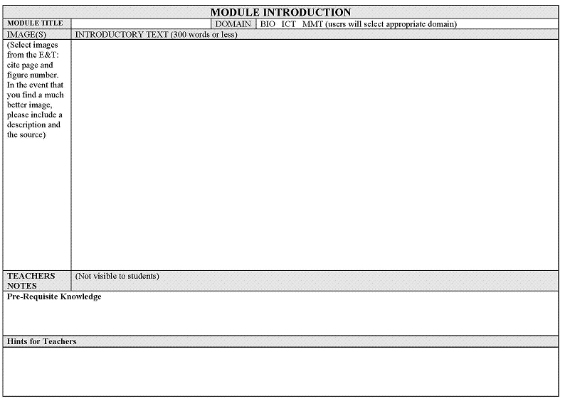
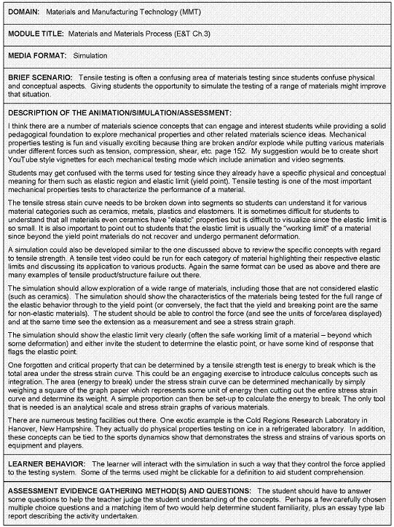
Pedagogical Approach:
On-line Writing Template and Media Development Template

Slide 11
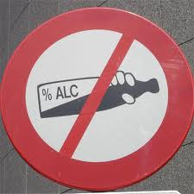
Procedures for
Filing for Reimbursements
As per 1/17/12 memo from Lois Miceli: Complete Travel Expense Report, Consultant Reimbursement Report, and W9 form. Please complete the W9 form only if you have not previously sent one.
Send itemized receipts to
Lois Miceli
Hofstra University Center
for STEM Research
773 Fulton Avenue
Hempstead, NY 11549
516-463-6482
Lois.m.miceli@Hofstra.edu
Sorry!

Slide 12
BILT Members
Kendall Starkweather, Executive Director, ITEEA (Chairperson)
Sandy Clark, Editorial Director, Delmar Cengage Learning
Sulatha Dwarakanath, Chief Scientific Officer, Nano Science Diagnostics
Charles Goodwin, Chair, NYS Technology Education Advisory Council
Michael Morton, Former CTE Director, Arlington, Virginia Public Schools
Scott Veibell, Manager, Technical Support, Cisco Systems
Bill Vitale, VP of Research and Development, Precision Elastomers
Cindy Weber, Superintendent of Schools, Durand Area Schools, Durand, MI.
Joyce Winterton, Senior Advisor for Education and Leadership Development at NASA Wallops Flight Facility

