Slide 1
ATEP Business and Industry Leadership Team Agenda
Sandy Clark, Director of Learning Solutions
January 20, 2012

Slide 2
We’re on the brink of a massive technology transformation in learning. No longer will the book be the primary individual student learning device.
Yes
And we know how to get there
No
Notes:
If we had been holding this meeting 10 years ago, I would have told you that there won’t be much of a market for printed texts in 5 years. 5 year ago when we were selling almost only printed texts to students, I would have told you that it should only be a matter of 5 years or so before we’re all digital. Today, a printed textbook is still the most ubiquitous medium for the student. (Educators have integrated technology for decades…remember film strips).
So, why such poor vision?
books are a value – a class set can live a decade. TX CTE adoption may be pushed out to 2018 (books 14 yrs old).
the economics of books are great for college students
technology challenges of medium and making
there is still no simpler, more democratic devise, very user friendly
What event will prove the tipping point for technology?
a device at a reasonable price?
industry standards?
economics of adoptions? TX supplemental science adoption?
documenting better learning through assessments … individualizing learning paths
So what are publishers doing to remain vital and transition through this period? We are moving down the digital path with these guidelines:
Content is king
Rights and perms are critical
Aim to be device agnostic
Developing transitional products that introduce technology along with a print solution
Working on technology prototypes that personalize learning paths
Write with learning outcomes and chunked content in mind (templates)
Always, always ask ourselves what problem we’re solving with our product

Slide 3




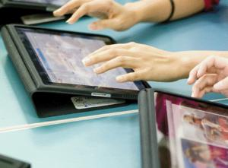

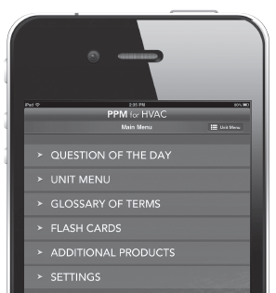
Technology Problem-Solvers
Instructor Materials
Class Media/Technology
Student Resources
Nurse’s Drug Reference App
Available NOW at iTunes!
Notes:
Instructor Materials … so 20th Century but they continue to be vital pieces of support for instructors. Easy to understand what problem we’re solving.
Class Media/Technology … again, nothing new and usually teacher-driven
Student Resources … empowering students, providing them with contextual tools to aid their learning
CourseMate: Technology supplements to a text = helping the transition along
Course360: Online learning, engaging outcomes based learning = hybrid learning benefits
Nurses Drug Reference App: On-the-go, easy to access information, smart: drug interactions, dosing
DATO – Delmar Automotive Training Online
Provides a focus on contextual learning, often within a conceptual framework for making learning applied and meaningful.
Your Research Park theme
May use the construct of an automotive shop, a virtual law office, an office technology park for meaningful learning that brings to life the question: “why do we need to know this?”
Focuses on the pain points:
Creating good diagnosticians
Providing practice online that makes the most of the valuable shop time
Efficacy Results of Automotive product: Instructors’ overall satisfaction with DATO is 8-9 on a scale with 10 being perfect
Dato Students are the best advocates…
“It’s as close to a real car you can get without it being a real car”
“Amazing. The ability to use a program that walks you step by step diagnostics procedures. I learned more from this program than any other prior program.”
“The DATO program is a great hands on learning experience and really challenges your mind.”

Slide 4

What our Instructors & Students tell us about Technology:
Technology can appeal to different types of learners and improve student satisfaction . . . they are ready to try
Content is critical
Simple is brilliant
Easy to use is critical; one place for all resources is ideal
Notes:
What does this mean for us, as we begin to design ATEP?
Content still needs to go through peer review, ideally in files, we’ll also contribute copyedit
Design will be tested during microtesting and more thoroughly in the pilot stage
We will look at everything from on-boarding to usability design

Slide 5
What our Instructors & Students tell us about Technology:
Instructor flexibility is vital
Tracking progress is important; being able to document effort and engagement is also important
Instructors expect students to use eBook, quizzing, glossary, lectures, and animations/videos daily; wanted flashcards, and puzzles used weekly. Study daily and Review weekly. In practice, student did the opposite.
Students still have a relationship with print, but the relationship is in transition….
Notes:
The first two bullets speak to harnessing the power of the LMS
We want to design with the LMS capabilities in mind, but not over-engineer. I am delighted and humbled when I hear customers using our products in new ways we hadn’t imagined. I would encourage us to keep the content chunked, the lessons small, and give our customers the ability to have some control over it. For example, being able to re-arrange lessons is important.
Speaking of humility, look at that 3rd bullet. It’s good to remember when designing our product that student may not want to use it as you have designed it. Allowing some flexibility all-around is important. Conversely, if there are key concepts or baseline information that needs to be acquired, test on it before allowing students to move on.
So, print is worth a discussion. As I mentioned, print is still where we’re reaching the bulk of students. One of the greatest negatives voiced by our customers on a new digital native/digital only product is that its digital only. Opps. So, we’re researching a print supplement option; it looks like we’re probably moving to something like a study guide.
I am not suggesting that ATEP should be planning a print product. But, we will definitely explore the print question in our reviews.

Slide 6
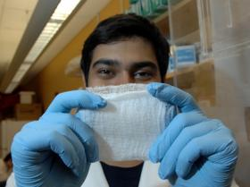

What an amazing time to be designing learning materials!
Know the ATEP mission. “Inspiring students to …”
Focus on the content; you are making the difference
Trust your ability to teach; it will guide the design
Be flexible
Inspire
Learning
Wonder
Fun!
Notes:
Efficacy Results of Automotive product: Instructors’ overall satisfaction with DATO is 8-9 on a scale with 10 being perfect
Dato Students are the best advocates…
“It’s as close to a real car you can get without it being a real car”
“Amazing. I learned more from this program than any other prior program.”
“The DATO program is a great hands on learning experience and really challenges your mind.”

