Slide 1
SED 264 – General Methods of Teaching
Orientation
Donna Levinson
Associate Dean of External Relations
Office of Field Placement
School of Education, Health, and Human Services
Hofstra University

Slide 2
SED 264 Basics
www.hofstra.edu/sed264visits
SED 264 – General Methods of Teaching has a very different field placement process than any other class. Most of this process takes place online at a special website: www.hofstra.edu/sed264visits
Field work for this class requires placements in high-needs districts, as designated by New York State.
“High-needs” refers to an economic indicator of high poverty rates within a district and/or school.

Slide 3
SED 264 Basics Continued…
  You will be required to make three (3) full one (1) day visits to fulfill the field experience requirements.
  Be sure that you pick dates and times that you are sure you can make (more on next slide).
  Remember to be courteous and professional during your observations. Not only are you a representative of Hofstra University but the impressions you make now may have an impact later when you are looking for a full-time position.

Slide 4
SED 264 – The Process
  Your instructor will be providing you with the necessary paperwork. One sheet will have the available locations and dates for field placement (Click here to see a screenshot of this sheet). The other form will describes the schools in more detail (Click here to see a screenshot of this sheet).
  You will be asked to log-in using your Hofstra ID and password (the same way you would log in to MyHofstra ) and the major that you are currently studying .
  From here, you will be able to browse and join the groups for field placement. Before you make any decisions, you must check your availability for the set dates and factor in your desire and/or ability to observe certain populations or in certain areas….

Slide 5
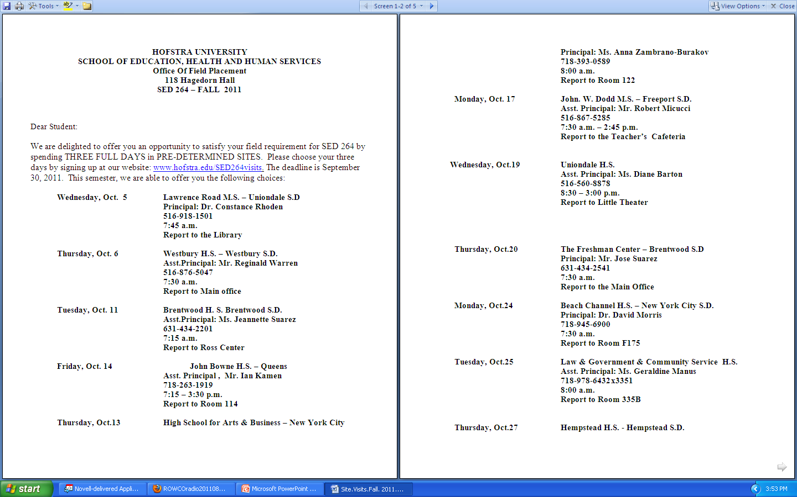
Available Locations and Dates for Field Placement Sheet
Click here to return to the “SED 264 – The Process” slide

Slide 6
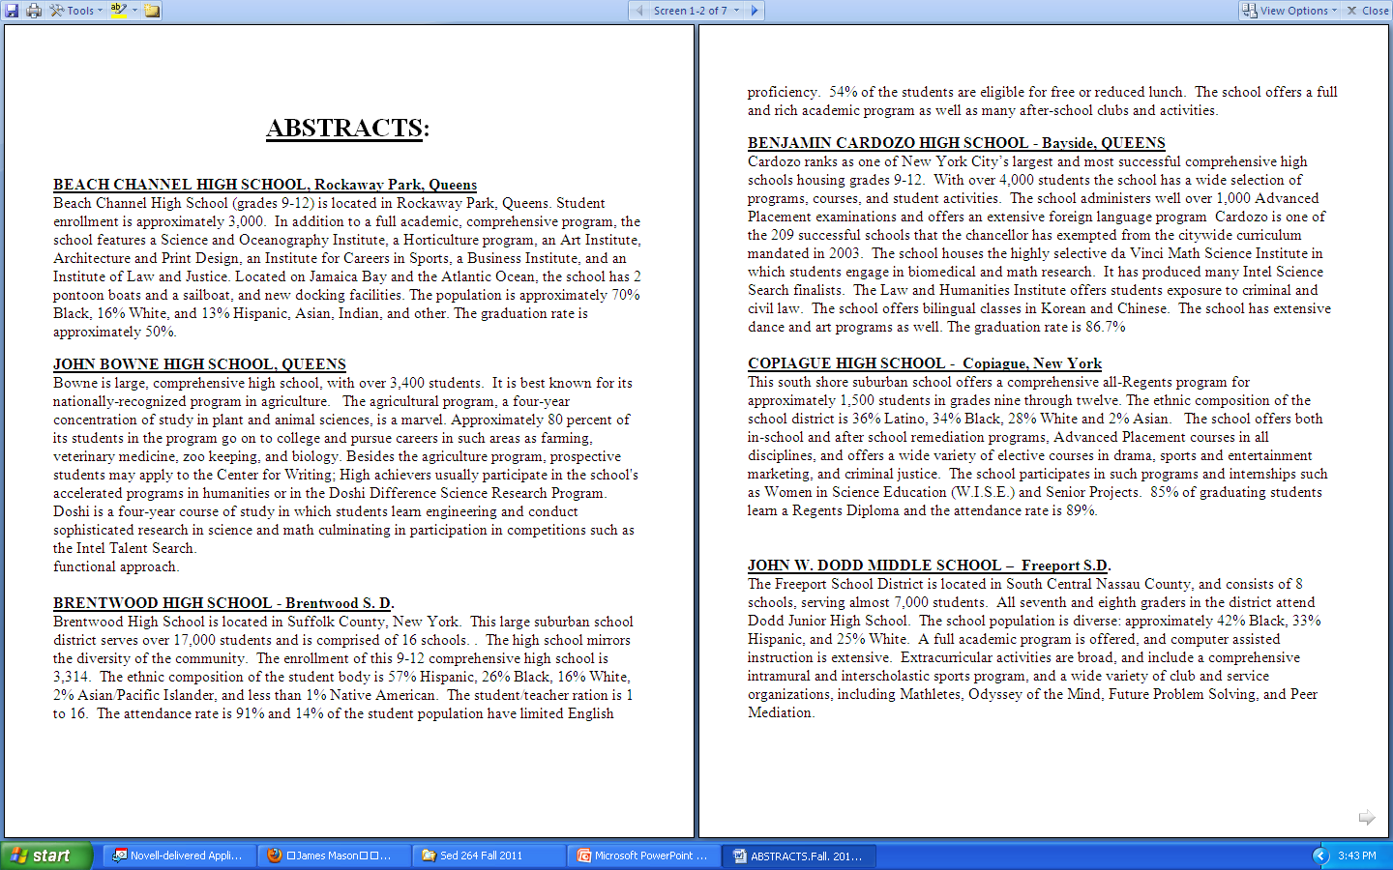
School Description Sheets
Click here to return to the “SED 264 – The Process” slide

