Slide 1

Room Selection 2011
Your step by step guide to Homesteading
Notes:
Greetings! The following is a presentation to help you understand the Room Selection process for 2011. We will take you through this step by step guide to ensure that you are fully aware of the Homesteading process.

Slide 2
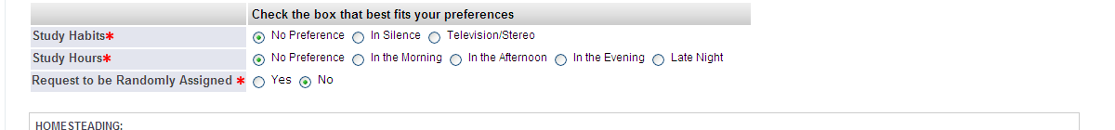
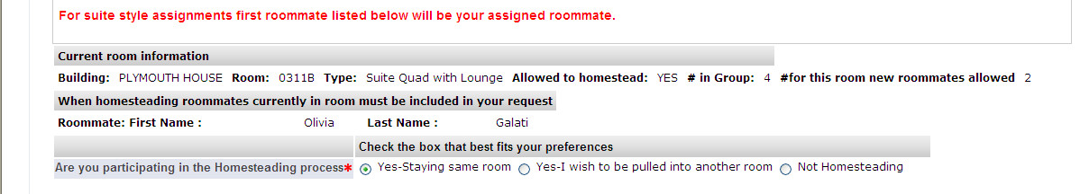
Things to do Prior to Participating in Homesteading
Pay your $300 Housing Deposit
Complete Housing Application
Indicate on your Housing Application one of the following:
  I wish to be Randomly Assigned
  I intend to Homestead
  I intend to be pulled in
  I do not wish to Homestead
If you have decided not to homestead your current room and select to be randomly assigned a new room by the Office of Residential Programs check off “Yes”.
Notes:
There are a few things that will need to be completed prior to participating in the Homesteading Process online. First you will need to submit your $300 housing deposit. This deposit can be paid online through your Hofstra Portal or at the Office of Student Financial Services located in Memorial Hall. Second you will need to complete your housing application which will indicate to us what room type you are hoping to obtain as well as roommate preferences and important contact information. When filling out the housing application, please be sure to indicate if you intend to be randomly assigned, homestead your space, or get pulled in to another room by a friend who is homesteading. If none of those options apply, then you must indicate that you do not wish to homestead- this will indicate to us that you intend to participate in the lottery process.

Slide 3
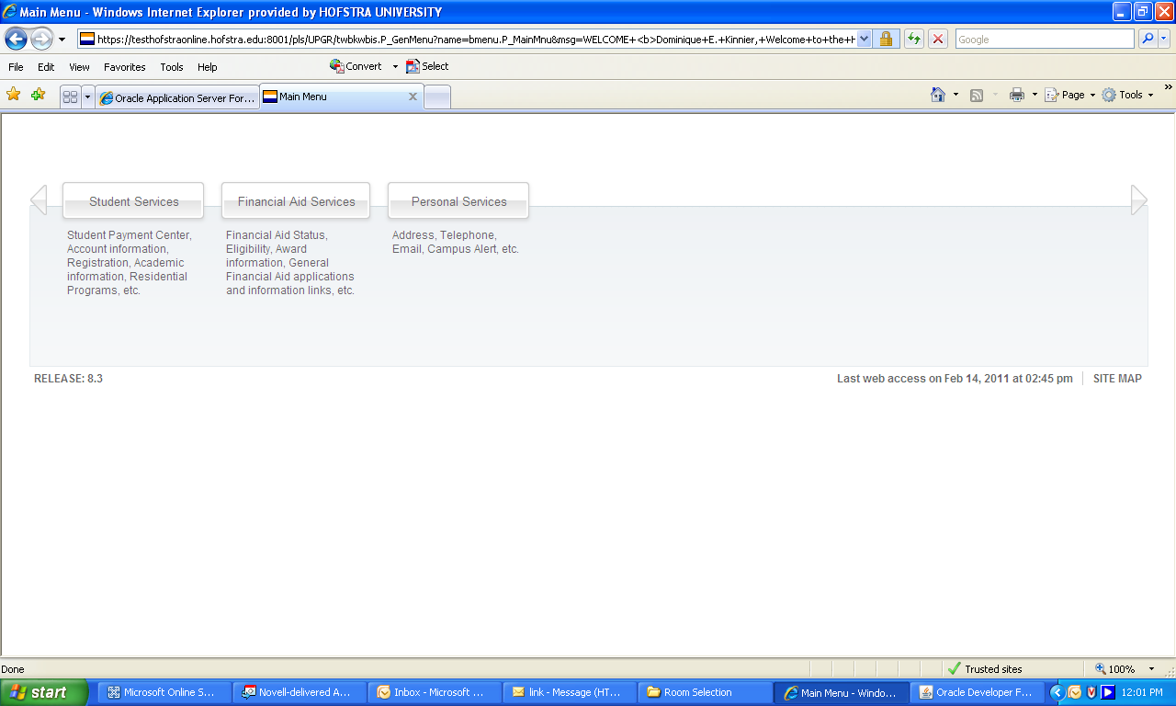
How to Homestead Your Current Room
Log onto my.hofstra.edu
Select “Student Services” button
Notes:
Let’s go through how you actually access the homesteading process online. First log in to your Hofstra portal account by visiting my.hofstra.edu. Once on your main page, select the Student Services tab as indicated by the picture below.

Slide 4
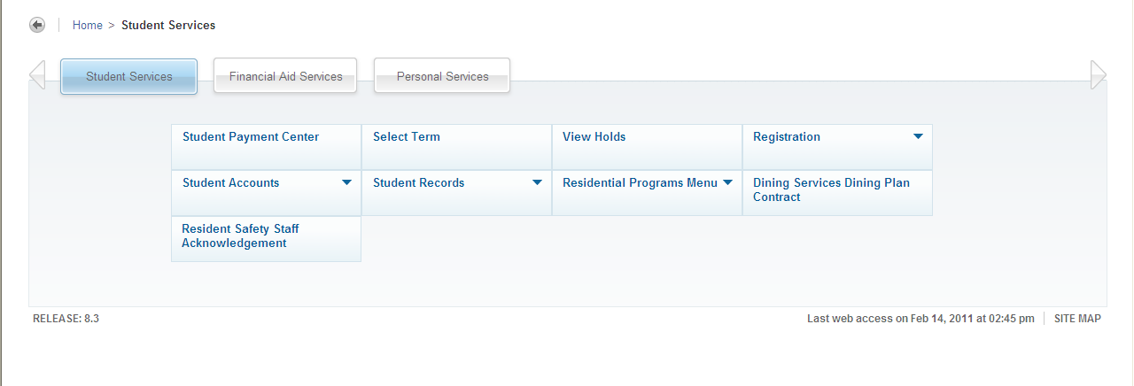
How to Homestead Your Current Room
3. Select “Residential Programs” Menu
Notes:
On the Student Services tab you will see the list of different menus, select the Residential Programs Menu to continue.

Slide 5
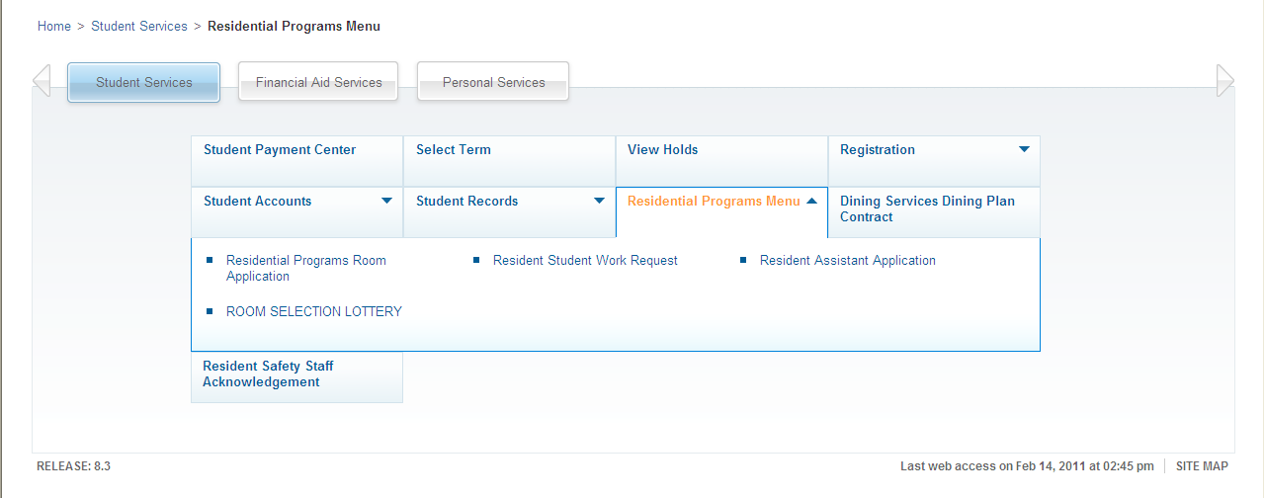
How to Homestead Your Current Room
4. Select “Residential Programs Room Application”
Notes:
Under our department’s menu, choose the Residential Programs Room Application option as seen below.

Slide 6
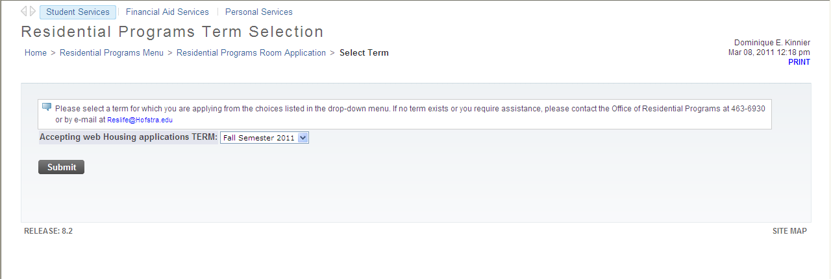
How to Homestead Your Current Room
5. Click Submit and follow the instructions to complete the Student Housing Application
Notes:
Verify that your name is accurate in the upper right hand corner of the screen and that the term listed is FALL 2011 and click submit.

Slide 7
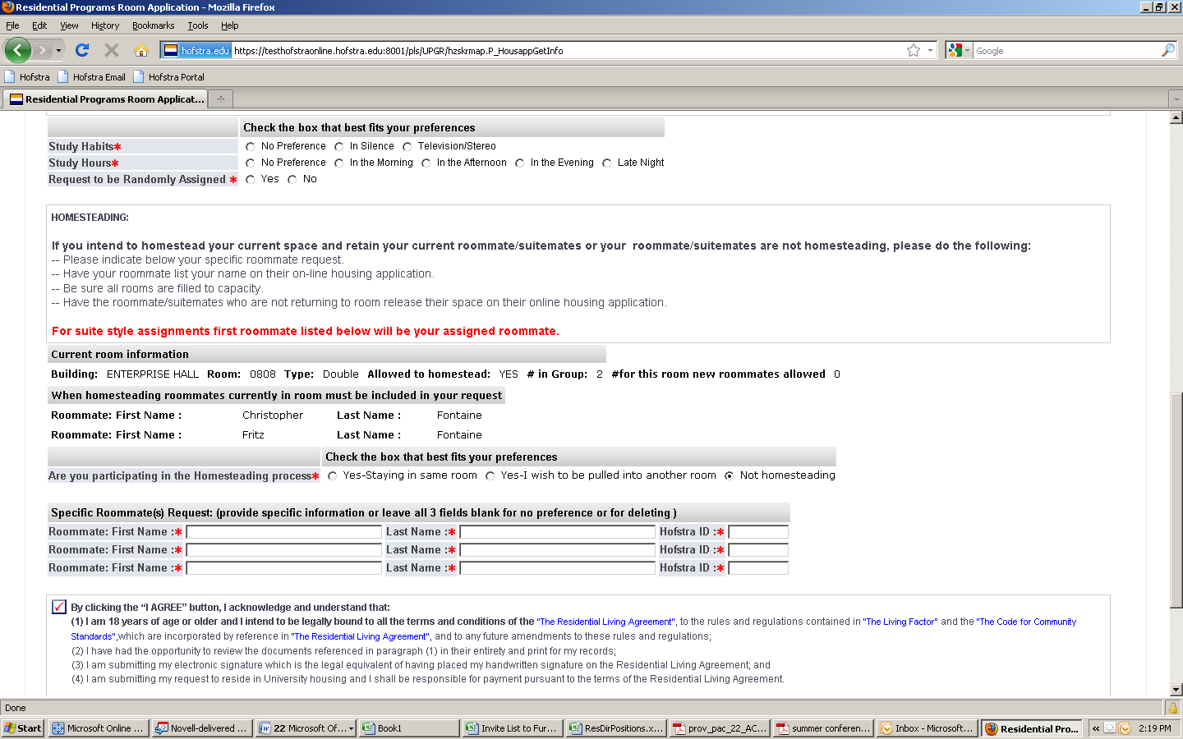
Things to Remember When Homesteading
Room MUST be filled to capacity
  If you want to live in a double room you MUST also select a roommate.
Indicates that the room is currently full and no student can be pulled in.
Indicates current residents.
Notes:
It is important that you fill the space you are looking to homestead with the proper number of people required for that room. In other words, a double needs two people, a triple needs three, a suite needs four, etc. The application page will indicate to you if the space is full or if you have the ability to pull another student in. If your roommate is not returning, they must release the room so you can homestead- we will discuss this process in a later slide.

Slide 8
Things to Remember When Homesteading
Have your roommate list your name and Hofstra ID # on their application as well.
List roommate/suitemates.
Notes:
You must have both the roommates complete name as well as their Hofstra identification number listed on your application and they will need to list your information on their application as well. This step is very important since it is how the system will verify that you both have chosen to live together.

Slide 9
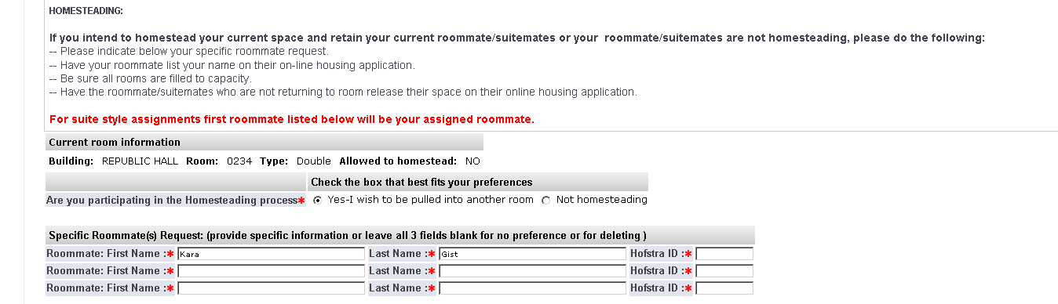
Things to Remember When Homesteading
Have current roommate/suitemate who are NOT returning to the room release their space on their housing application.
  If your roommate is NOT returning to housing they MUST access their housing application and release their space, by indicating “not homesteading.”
Checking either option will release your space.
Notes:
As mentioned before, if your current roommate is not returning and does not want to homestead the space, they will need to release the room so you can pull in other students. They can do this by simply choosing the “Not Homesteading” option in the housing application. This will need to be done even if they are not participating in the lottery process at all, it is the only way we can ensure that the space is available for others.

Slide 10
Things to Remember When Homesteading
As a homesteader in a suite, in order to secure a particular roommate you MUST list that individual FIRST in the specific roommate request section of the application.
The first person listed will be your actual roommate.
Notes:
In order to make sure the correct roommates are assigned in cases where you will be in a suite style room, the first person listed in the Roommates Request section must be the person you intend as your actual roommate. The other spaces can be utilized for your suitemates or can simply be left blank if the spaces do not apply. Please make sure all information is accurate when you enter it into the system.

Slide 11
Homesteading Pull In Process
During the Homesteading Process students have the ability to pull other students into their room if there is going to be a vacancy.
For students living in Colonial Square or Nassau/Suffolk Halls, it is imperative that the student(s) being pulled into a vacant space MUST submit their Housing Application first indicating their preferred roommate and suitemates.
Notes:
If you are pulling any students into your current space you must make sure that they complete their housing application FIRST. By completing it before you, the system can recognize that they have agreed to being pulled in and agree to all of the roommates and suitemates listed within your application as the homesteader.

Slide 12
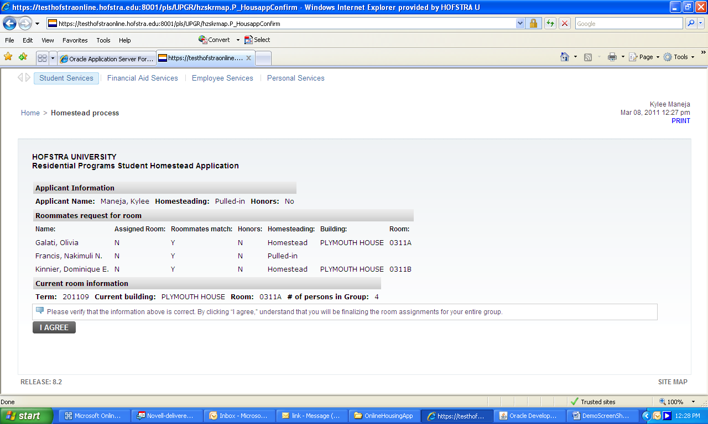
Once Your Homesteading/Pull In Application is Complete
  Once all students being pulled in have updated their Housing Applications the person(s) Homesteading should then update their Application indicating their preferred roommate and suitemates.
Indicates students being pulled into the room.
Notes:
After all housing applications are completed, the actual homesteader will be responsible for updating their housing application stating their preferred roommates and suitemates. As you can see in the picture below, it will register who has indicated that they are homesteading and/or being pulled in to the space. The homesteader then will verify the information by clicking “I Agree.”

Slide 13
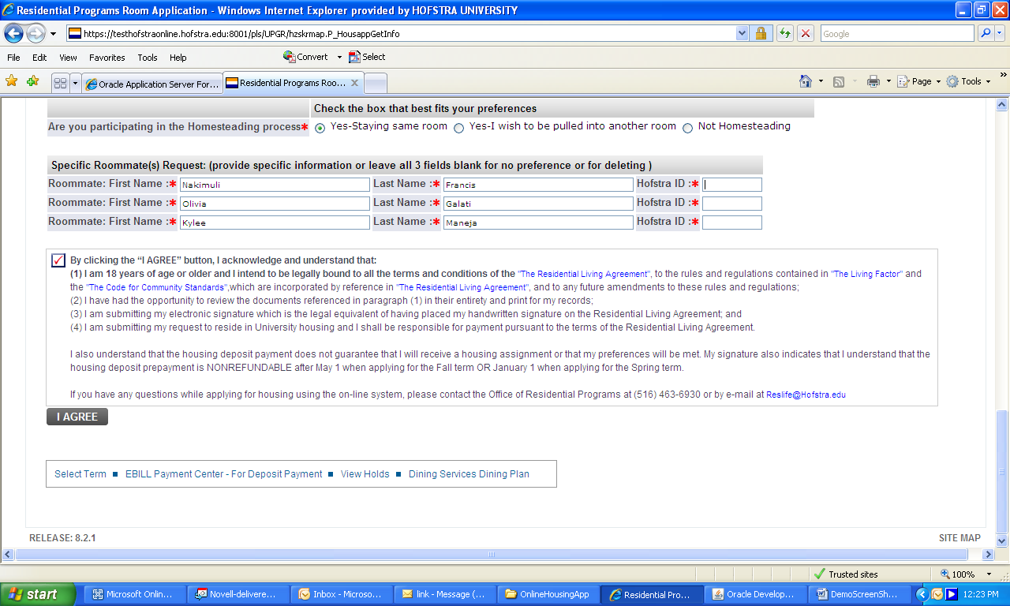
Final Submission
By clicking the “I Agree” button you are agreeing to “The Residential Living Agreement”, “The Living Factor” and “The Code of Community Standards”.
Notes:
By clicking I agree on the housing application, please note that you are responsible for adhering to the rules and regulations of on campus living that are listed in our Residential Living Agreement, Living Factor, and the Code of Community Standards. Once you do this, you will receive your final notification for housing.

Slide 14
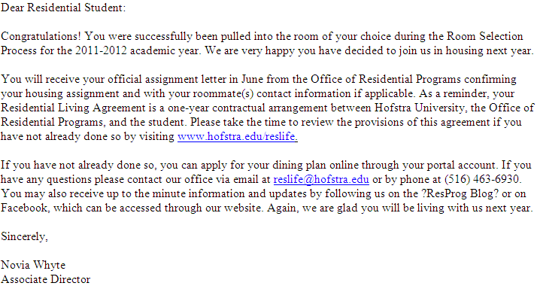
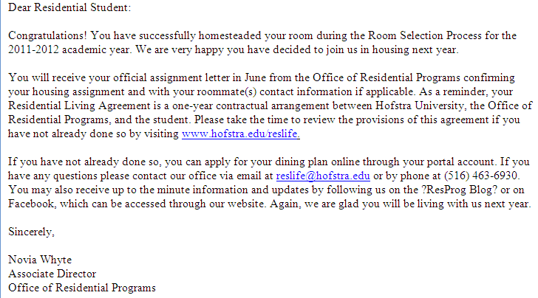
Final Notification
All parties involved will receive a confirmation email to their Hofstra Pride account within minutes of homesteading or being pulled into a room/suite.
Notes:
Your final notification will be emailed to your HOFSTRA PRIDE ACCOUNT immediately upon receipt of your homesteading application. Some examples of what you will receive are pictured below.

Slide 15
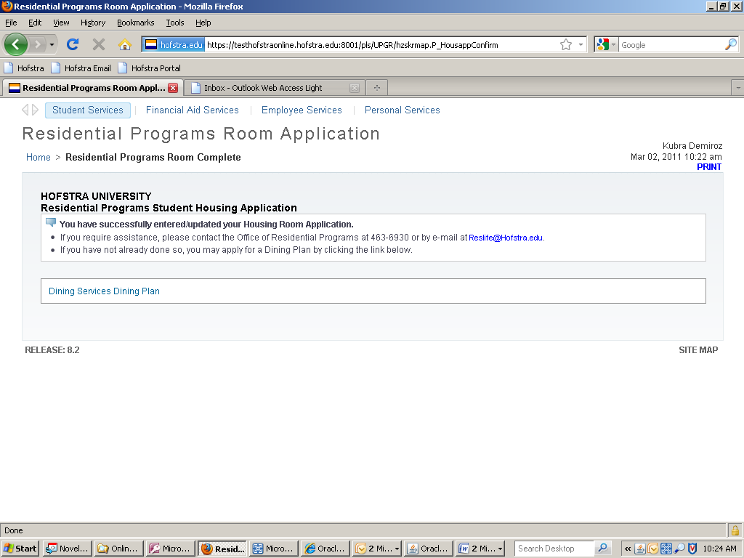
Final Notification
Students will not have the ability to access their Housing Applications to make any changes once they have selected a room for the upcoming academic year.
Notes:
After you have successfully completed the housing application and the homesteading process, you will no longer be able to change your preferences or participate in the lottery process for the upcoming academic year. If you have questions or concerns, please feel free to contact your Resident Director or the Office of Residential Programs for assistance. HAPPY HOMESTEADING!

