Slide 1

Room Selection 2011
Your step by step guide to
The Lottery Process
Notes:
The following presentation will help guide you through the Lottery Process for housing selection for Fall 2011.

Slide 2
Things to do Prior to Participating in Room Selection
Pay your $300 Housing Deposit
Complete Housing Application
Notes:
In order to participate in the room selection process, you will need to make sure you pay your $300 housing deposit and complete a housing application. Both of these things can be completed through your hofstra portal.

Slide 3
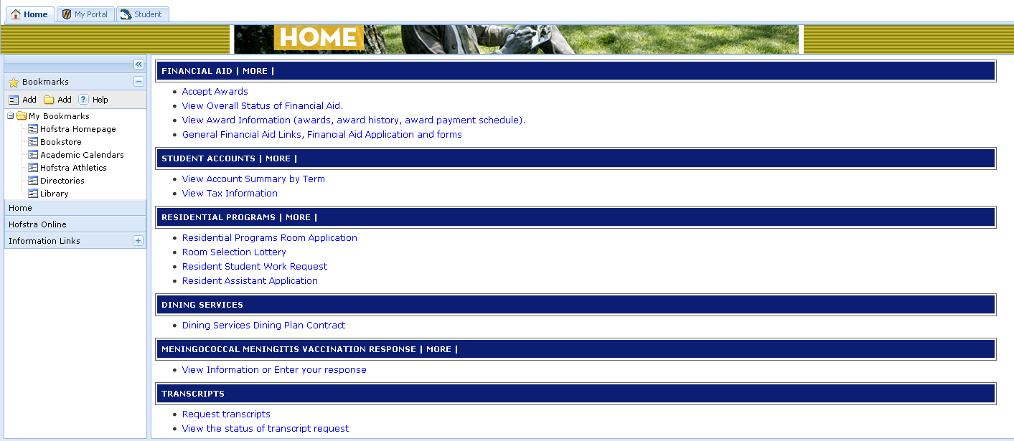
Check for Available Spaces
After logging into your Portal Account, scroll down to the Residential Programs menu and select Room Selection Lottery.
  This allows you to view your lottery date/time and all available spaces on campus.
Notes:
To check the status of available rooms on campus students can at any time log into their portal account and select the room selection lottery link under the residential programs menu. Available rooms are listed in the order of single rooms followed by double, triple and four person suites. By clicking on this link students will also have the ability to see their designated lottery date and time.

Slide 4
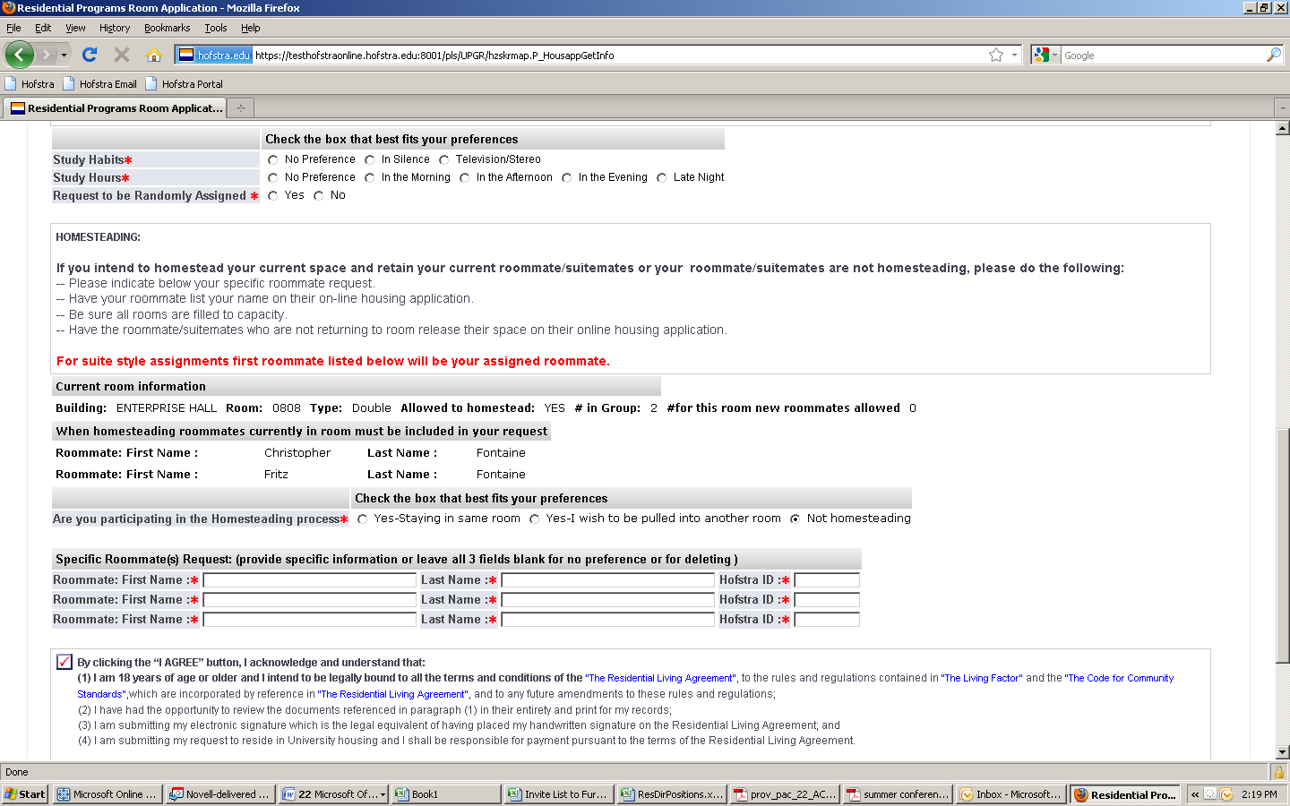
Things to Remember When Selecting a Room During Lottery
Room MUST be filled to capacity
  If you want to live in a double room you MUST also select a roommate.
Indicates that the room is currently full and no student can be pulled in.
Indicates current residents.
Notes:
While going through the lottery process please remember that you must fill each room to capacity. In other words if you are choosing to live in a double you must have two people, if you want a triple you must have three people, if you’d like a suite then you must have four people.

Slide 5
Things to Remember When Selecting a Room During Lottery
Have your roommate list your name and Hofstra ID # on their application.
List roommate/suitemates.
Notes:
In addition, make sure you have the correct name and identification number for all of the members of the room that you want to live with. You will list your roommates in the Specific Roommate Request section as seen here.

Slide 6
Things to Remember When Selecting a Room During Lottery
In order to select a particular roommate in Colonial Square or Nassau/Suffolk Halls you MUST list that individual FIRST in the specific roommate request section of the application.
The first person listed will be your actual roommate.
Notes:
One important thing to note is that you must list your preferred roommate in the first available section in cases where you are looking to live in a suite. The suitemates will be listed after that.

Slide 7
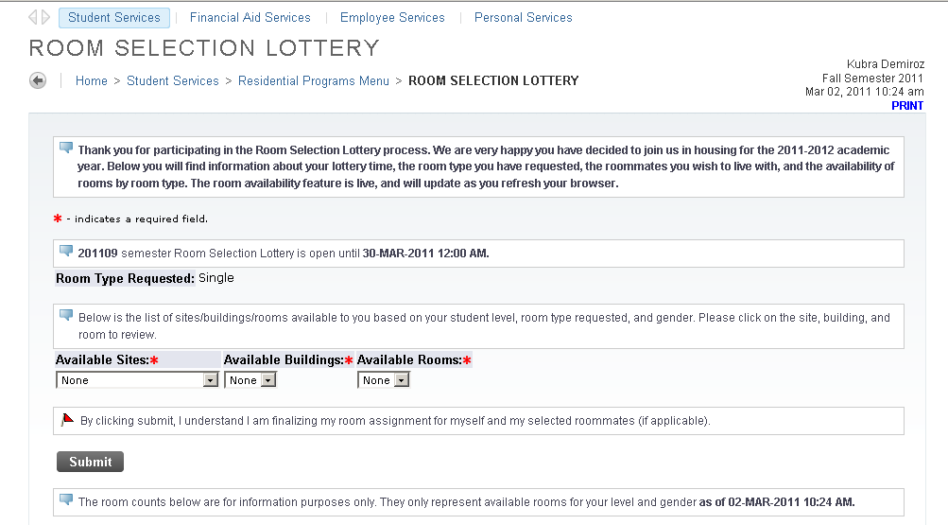
Here is an Example…
Searching for available singles
Your selected room type based on the number of people in your group.
Notes:
Here we will show you an example of how the process works. The Room type requested should be automatically listed based on the number of preferred roommates you originally indicated. In the example shown this student is choosing to live in a single room.

Slide 8
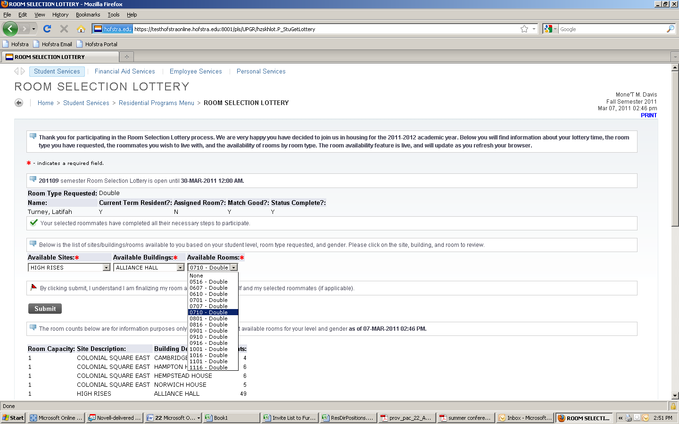
Here is an Example…
Searching for available doubles
Your selected room type based on the number of people in your group.
Drop down menus to select your housing preference.
List of available double rooms throughout campus.
Notes:
In this example the student is looking for a double room. Students will see a drop down menu listing all available rooms. This will be updated automatically throughout the lottery process as students choose rooms.

Slide 9
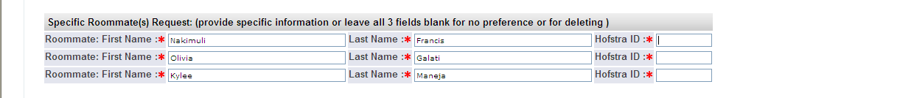
Here is an Example…
Are you looking for a kind of room/area that is no longer available?
  You have two options:
    Reconfigure your group
      If you are a group of four and looking for a four person suite, you should split up into groups of two and split up into two double rooms. You should then remove the two people you no longer intend to live with from your preferred roommate list.
Remove the people you no longer intend to live with.
Notes:
If by chance, you find that the room type you prefer is no longer available then you will have two options moving forward. You can either reconfigure your group and delete members from your specific roommate request area or you can request to be randomly assigned as shown on the next slide.

Slide 10
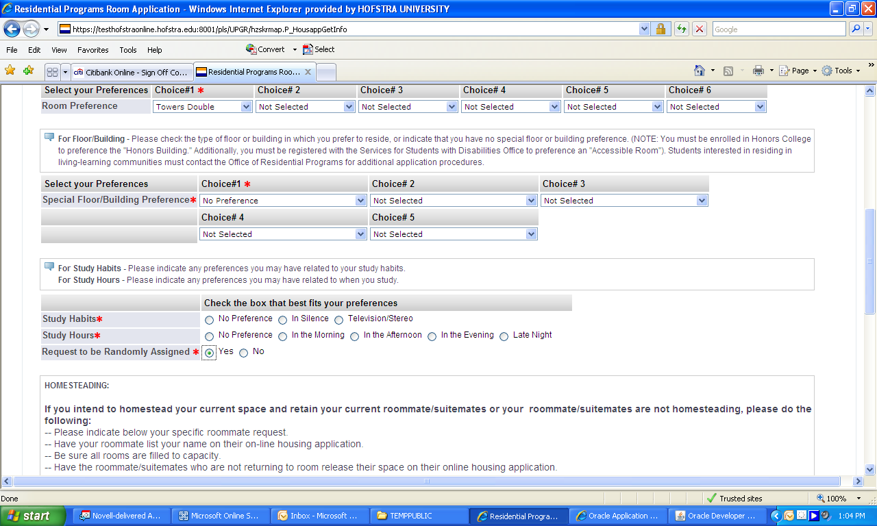
Here is an Example…
  You can also Request to be Randomly Assigned if you cannot find the kind of room you are looking for during the lottery
      Go back and indicate “Yes” where it asked if you would like to be Randomly Assigned.
Notes:
If the room you are looking for is not available you can always ask for random placement to be done by the Office of Residential Programs. In order to do this go back to the section inquiring about your study habits and the third question should be switched to “Yes” to be randomly assigned.

Slide 11
Final Submission
By clicking the “Submit” button, you are finalizing your (and your roommate(s)) room assignment. This cannot be changed.
Notes:
Once you click the submit button, the process is final and no additional changes can be made. You are not only finalizing your room but who you’ve chosen as roommates as well.

Slide 12
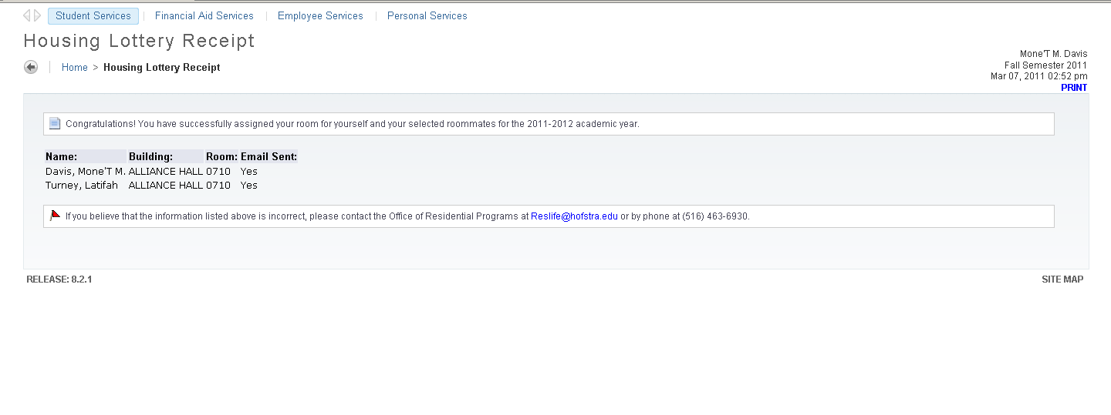
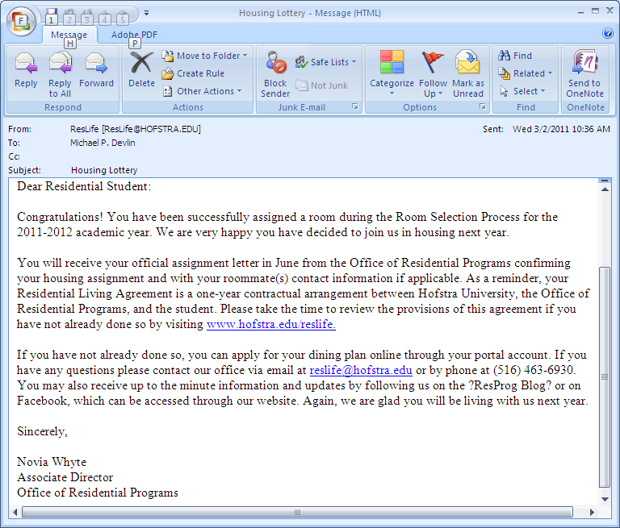
Once Your Lottery Selection is Complete
This is your confirmation screen on the housing application.
This is an example of the email you will receive once your housing selection is confirmed.
Notes:
Upon completing the lottery process you will automatically receive an email to your HOFSTRA PRIDE ACCOUNT confirming your placement. Please be sure to verify that you receive your confirmation email after completing the lottery process.

Slide 13
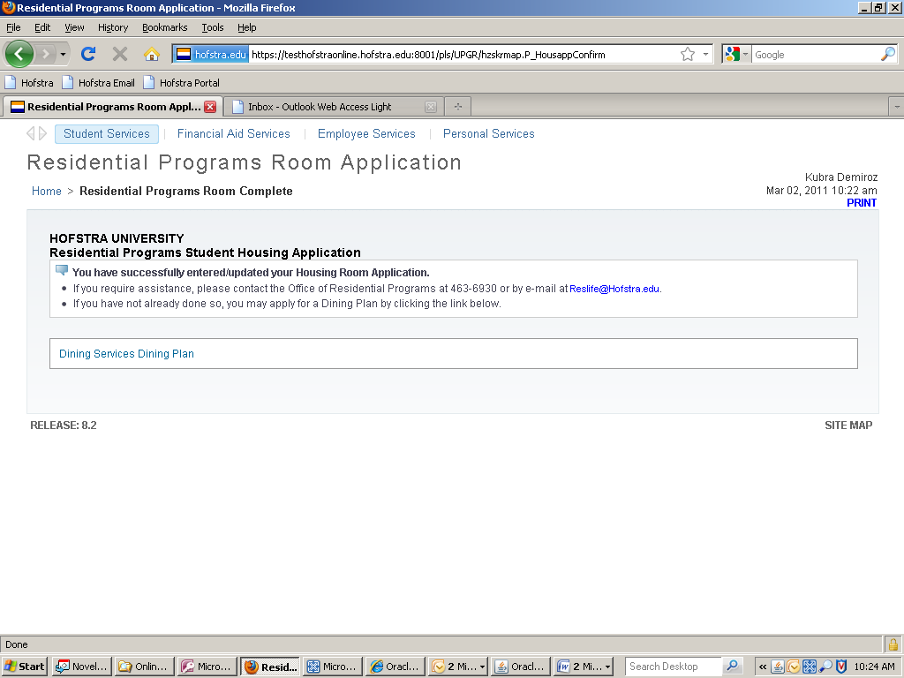
Final Notification
Students will not have the ability to access their Housing Applications to make any changes once they have selected a room for the upcoming academic year.
Notes:
Once completed, you cannot go back to make any changes so if you have questions or concerns moving forward, feel free to visit us in 244 Student Center. Thank you for participating in the lottery process and GOOD LUCK!

