Slide 1
Middle States Accreditation Standards and Processes

Slide 2
Middle States Mission Statement
“The Middle States Commission on Higher Education assures students and the public of the educational quality of higher education. The Commission’s accreditation process ensures institutional accountability, self-appraisal, improvement, and innovation through peer review and the rigorous application of standards within the context of institutional mission.”
Notes:
http://www.msche.org/documents/ProcessChangeMemo.pdf

Slide 3
Requirements of Affiliation and Standards for Accreditation
Four Principles found in the Introduction (p.1) guide the foundation for our work:
Mission-centric standards acknowledge the diversity of institutions
Focus of the standards is on the student learning experience
Standards emphasize the importance of continuous improvement
Standards support innovation as essential to higher education
MSCHE Standards for Accreditation What you need to know [PowerPoint Slides]. Retrieved from http://www.msche.org/documents/RevisedMSCHEStandards-WhatYouNeedtoKnow.pdf

Slide 4
Requirements of Affiliation and Standards for Accreditation
A HIGHER EDUCATION INSTITUTION
Has a mission (Standard I)
And lives it with integrity (Standard II)
To enhance the student learning experience (Standard II)
And support the overall student experience (Standard IV)
THAT INSTITUTION
Assesses its success in achieving that mission (Standard V)
And engages in planning to strengthen its resource and improve an institution (Standard VI)
By means of an effective governing process (Standard VII)

Slide 5
Requirements of Affiliation and Standards for Accreditation
Revised standards = 11 pages (vs. 68)
7 standards rather than 14
Simplicity of Standards: 1-2 sentence statements; criteria
Structure: centrality of mission (mentioned 20 times); ethics builds on mission; students at the front; planning and governance support the students
Assessment built into every standard

Slide 6
Standards of Accreditation: 12th & 13th Editions Mapped Out
13th Edition | 12th Edition
Standard 1: Mission and Goals | Standard 1: Mission and Goals
Standard 2: Ethics and Integrity | Standard 6: Integrity
Standard 3: Design and Delivery of the Student Learning Experience | Standard 10: Faculty Standard 11: Educational Offerings Standard 12: General Education
Standard 4: Support of the Student Experience | Standard 8: Student Admissions and Retention Standard 9: Student Support Services
Standard 5: Educational Effectiveness Assessment | Standard 13: Related Educational Activities Standard 14: Assessment of Student Learning
Standard 6: Planning, Resources and Institutional Improvement | Standard 2: Planning, Resource Allocation, and Institutional Renewal Standard 3: Institutional Resources Standard 7: Institutional Assessment
Standard 7: Governance, Leadership, and Administration | Standard 4: Leadership and Governance Standard 5: Administration

Slide 7
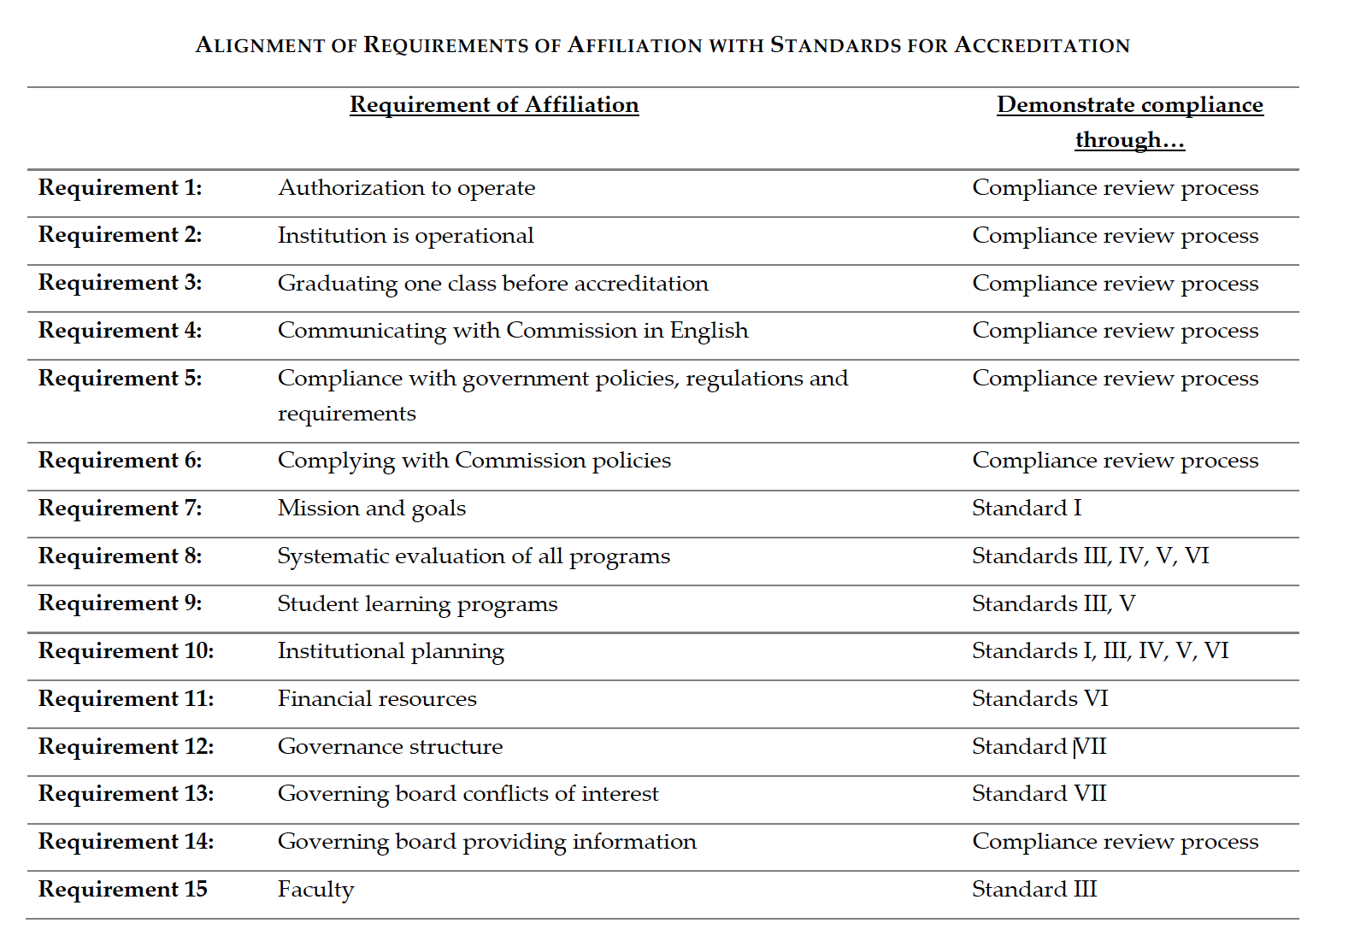
Requirements of Affiliation

Slide 8
Key components of the Self-Study
Self-Study Narrative
Focus of the Self-Study Narrative is on Institutional Improvement in the context of the standards
Narrative report on Major Initiatives
Identified in previous Self-Study
Initiated since last Self-Study
Planned future initiatives
Broad in scope; having major impact on large sectors of the institution
Linked specifically to appropriate Standards (note final criterion for each Standard)
Clark, Robert, K. Accreditation Process Change: Developing a Holistic Approach. 2016 Middle States Town Hall, http://www.msche.org/documents/Fall2016TownHallSlides.pdf

Slide 9
Steering Committee
Led by Provost and Senior Vice President for Academic Affairs, Gail Simmons, and Senior Vice President for Planning and Administration, Pat Adamski
The Steering Committee
Composed of working group Chairs and others
Facilitates communication between working groups
Integrates findings across Standards
Edits and refines the final report and determines final recommendations

Slide 10
Overview of Working Groups
Our MSCHE Working Groups are organized around each Standard (7 Working Groups) and related Requirements of Affiliation
Primary task for Working Groups is to determine and demonstrate that the Standards and Requirements have been met, by:
Engaging in a process of discovery
Gathering data
Critically analyzing that data
Identifying strengths and challenges
Making recommendations that will further support Hofstra University’s mission, goals, and strategic plans

Slide 11
Overview of Working Groups
Each working group has two Co-Chairs who coordinate and support the activities of working group:
Co-Chairs are also members of Steering Committee
Each Working Group must
Populate the Documentation Roadmap
Incorporate assessment activities
Document what has been learned from that assessment
Suggest areas for improvement
Output for each Working Groups is a written draft section of the Self-Study report for its assigned Standard
The resulting narrative for each Standard tells the unique story of how Hofstra University meets that Standard in sustainable, reliable, and innovative ways

Slide 12
General comments about Working Group reports:
Please limit the report to about 20 pages, excluding appendices
Refer to specific elements of the Standard and Requirements of Affiliation in your discussion
Consider overlap between Standards and consult with other working groups as appropriate, and note the overlap in your narrative to avoid redundancies
Evaluate strengths and weaknesses in a constructive and factual tone
Consider the past 10 years of Hofstra’s history in your analysis, since the last full review

Slide 13
General comments about Working Group reports:
Include comments on Standard elements that the Working Group believes the University could develop over time. The Steering Group will consider these comments, and versions may become recommendations in the final document.
Along with other appropriate materials, please refer to the 2014 PRR and the 2008-09 Self-Study report found in the documentation folder at: S:\MSCHE 2018-19 Self Study\Documentation.
Not every recommendation from the Working Groups will be included in the final report. Groups should keep a separate suggestion list for all ideas for improvement.

Slide 14
Timeline for Working Groups
Apr-May Working Group initial meetings
May 11 MSCHE VP Liaison visit
Sept-Dec Working Group meetings to review data, outline chapters, update Documentation Roadmap
Jan 2018 Working Group first drafts due to Steering Committee
Feb-Apr Working Group meetings
May 15 Working Group “final” drafts due to Steering Committee
Fall 2018 Review, community-wide discussion of Self- Study, and revisions; Draft to Team Evaluator Chair
Feb 2019 Self-Study due to Visiting Team
Mar-Apr Visiting Team on campus
June MSCHE Determination

Slide 15
Resources
Logistical support: Toni Fazler, Coordinator for Events and Communication
Institutional Research: Stephanie Bushey, Vice President
Writer: Craig Rustici, Chair of the English Department, Professor of English
Academic Assessment & Student Learning Outcomes: Terri Shapiro, Sr. Vice Provost
Shared drive: S:\MSCHE 2018-19 Self Study
Middle States publications
Documentation Roadmap, past MSCHE Self Study and PRR
Folder for each Standard Working Group
Committee Membership & Charge
Self Study Design

Slide 16
Questions?

