Slide 1

WISEngineering
Achieving Scalability and Extensibility in
Massive Online Learning
WISE 2015
X. Fu, T. Befferman, J. Chiu, M.D. Burghardt
Notes:
0.5 min
This talk introduces a massive online platform and how we integrate machine learning and achieve scalability and extensibility.
Join work HU and UVA.

Slide 2
Outline
Introduction
Research Problems
Case Study: WISEngineering
  System Features
  Achieving Scalability & Extensibility
Future Directions
Notes:
0.5 min
We will start from a brief introduction of the research problems that we are facing and then we will introduce
The features of the wisengineering system and how we are able to achieve scalability and extensibility of the system.
Intro & Research Problems – Why and What’s the interesting research problems here? – 5 min
WISEngineering System Feature Introduction – 10 min
Solving Scalability and Extensibility – 8 min
Future Directions – 3 min
Total: 25 minutes

Slide 3
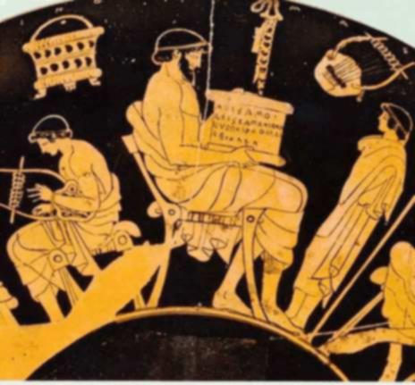
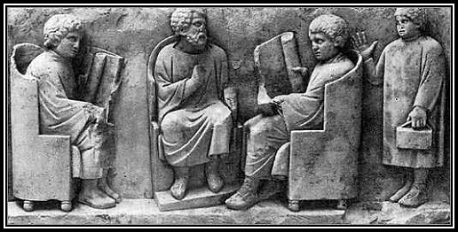

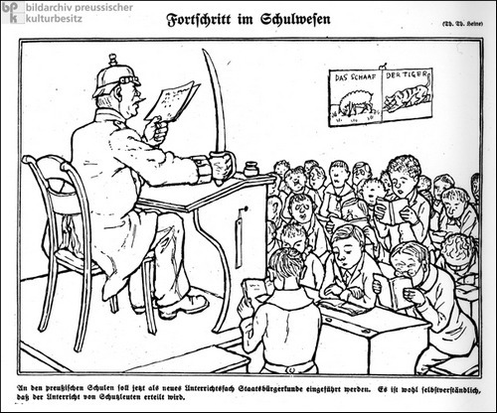
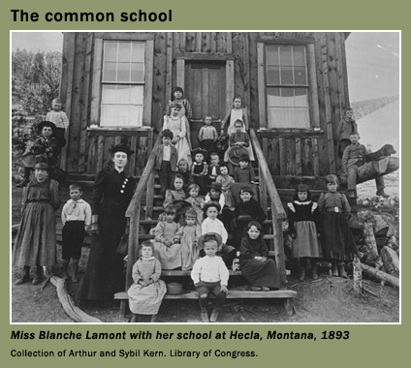
This History of Education Reform …
Greek
Rome
China
Image sources: [1,2,3,4,5]
19th Century Prussian
19’th Century U.S
Notes:
1.5 min
If you look at the history of education, from ancient Greece, Rome to India and China, there are numerous waves of education reforms. Most of them, the goal is to make education more accessible and to lower its cost. These education reforms usually lead to drastic social changes and they are accompanied by technology renovations of the time.
For example, the two kids in the picture of Rome must be very rich – because they have books. For most of students in a Roman school, dictation is a must because there’s no books. Similarly, education starts to reach less than 10 percent of population in China about one thousand years ago because of the invention of printing techniques (wooden movable type)
It is the advancement of technology that makes education affordable by the entire population.

Slide 4
MOOCs Platforms
Learning Analytics
Grading
Wiki
OpenEdX
Moodle
Canvas
Docebo
Saikai
Blackboard
User Management
RSS Feeds
Content Delivery
Team Collobaration
Digital Certificates & Badging
Social Sharing
Notes:
1.5 min
With the wave of massive open online education, a variety of learning management systems or so called online education systems are thriving. From the traditional web based systems such as Blackboard, open source and modular system such as Moodle to the more recent OpenEdX.
These platforms embraces new technologies and platforms such as mobile app, social media, learning analytics, automated grading. They open numerous opportunities for educators and researchers.

Slide 5






Case Study: WISEngineering
Notes:
0.5 min
We would like to introduce WISEngineering, yet another learning platform that embraces social media and massive online learning. It serves as a case study of the fast evolving learning management system.
----------------------------------------------------
Slide – animiation from Microsoft standard template -> pictures

Slide 6

Interesting Research Problems
Address Lack of Feedback of Massive Online Learning?
Rapid Prototyping of a Learning Theory?
Achieve Scalability & Extensibility?
Notes:
1 min
Why WISEngineering? Before we implement the system, we are interested in exploring the following research questions:
1> Achieving functionality
4> Scalability and extensibility?
We’d like to drill into the design and implementation details of the system and look at how we are able to build a low cost and fast prototyping learning platforms using an open architecture.
Part I – 5.5 min

Slide 7
WISEngineering Architecture
Outcome Analysis
Auto-Grading
Mobile Portal
Berkley WISE
Notes:
1 min
So here, we are talking about “low cost” – in fact less than 6 person months. But we also want to build a lot of new features such as automated grading and we’d like to prototype the learning theories from our educational theory researchers. This decides that we’re going to use an open architecure. We decide to based our system on a learning management system called WISE, from UC Berkeley.

Slide 8
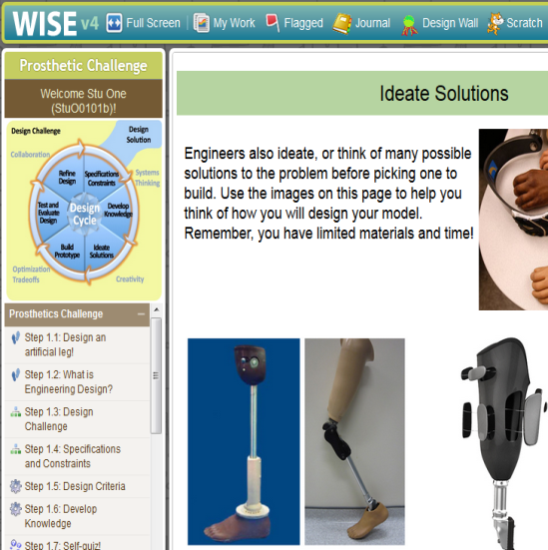
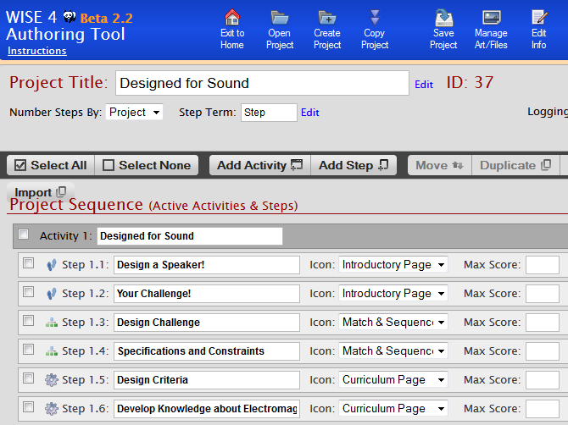
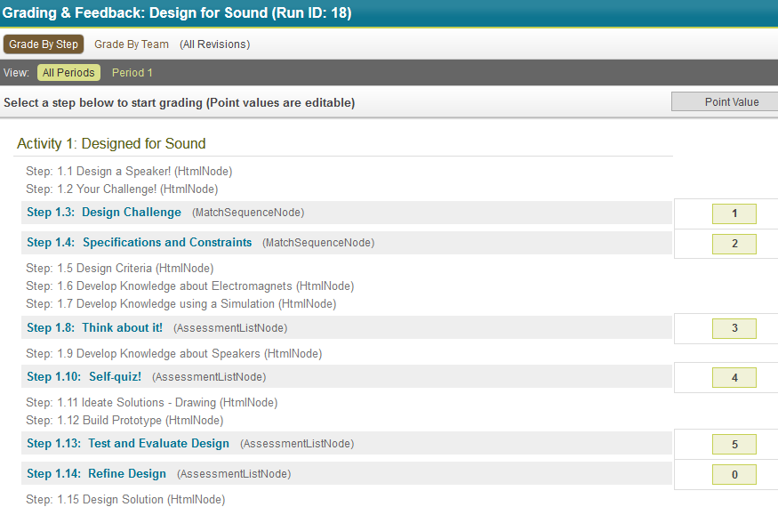
Berkley WISE
-- Web Based Inquiry Science Environment
Notes:
1 minutes
BerkleyWISE – provides traditional courseware management
[1] contents delivery
[2] course authoring
[3] evaluation

Slide 9
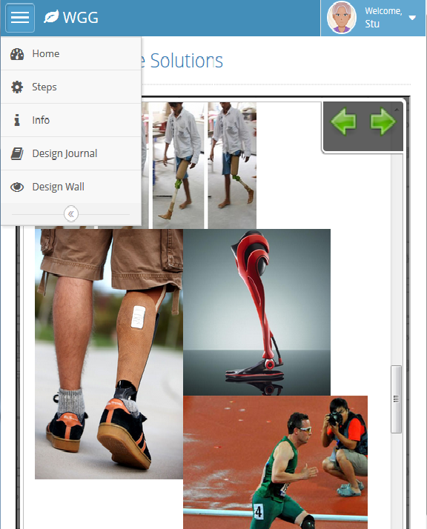
WISEngineering Features
Mobile Portal: Chrome Web App on 7’ Android Device
Notes:
0.25 min
WISEngineering Portal

Slide 10
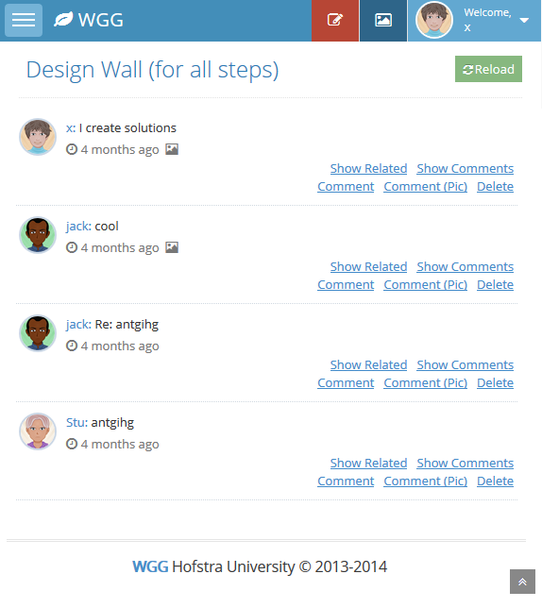
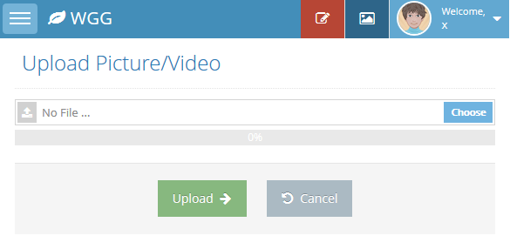
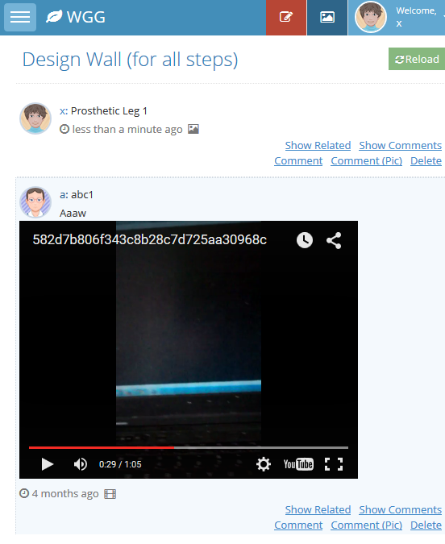
Notes:
A couple of more screen shots (0.25 min)
Design journal, design wall, video post

Slide 11
Automated Grading
Define
Learning
Outcome
Goals
Train
Machine
Learning
Data Set
Analysis
Outcome
Reports
Notes:
1.5 minutes
One problem with massive online learning is the lack of feed back from teachers. For this, we’ve developed
Automated grading, instant feedback, and learning outcome analysis system.
Three steps in learning outcome analysis
[1] define learning outcome goals
[2] train the machine learning algorithm
[3] generate the learning outcome reports

Slide 12
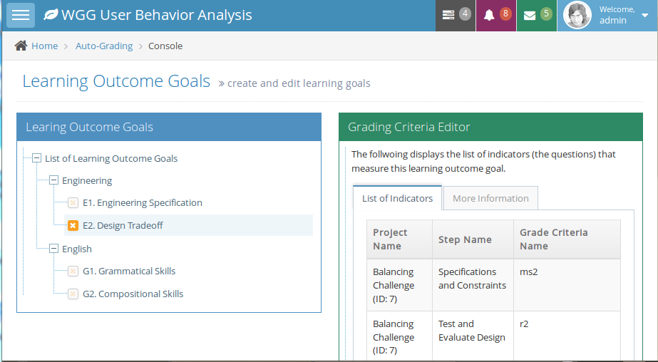
Learning Goals
Notes:
1 min
Before developing a course curriculum, educators can define the overall learning outcome goals. For example, here we are talking about engineering education for middle school age kids. The educational goals include if students understand the design trade offs and can clearly document the specification and constraints of an engineering project. We also examine the English writing skills of students.

Slide 13
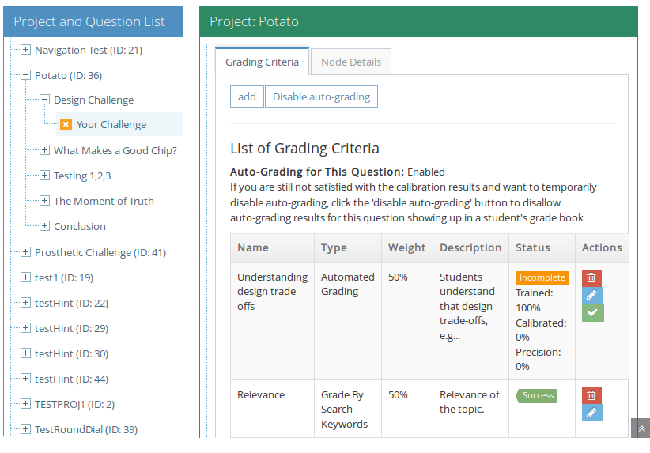
Training Criteria
Notes:
1 min
Explain how to define training critera
1> each question can have multiple criteria, reflecting different learning goals
2> each criteria can be graded by a specific method.

Slide 14
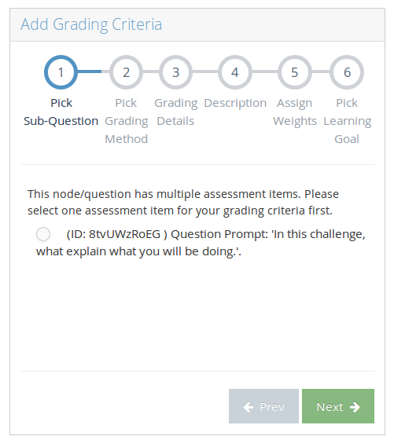
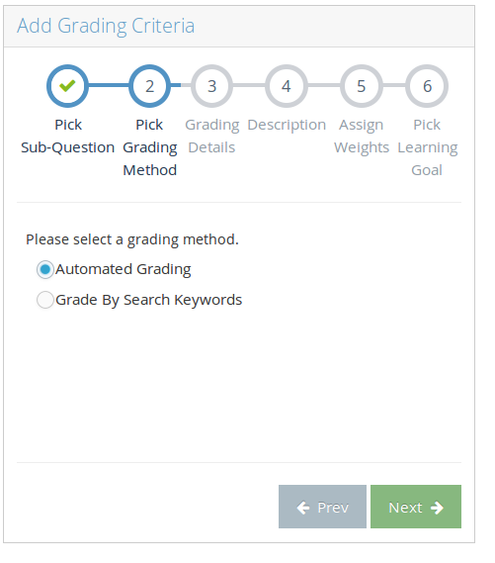
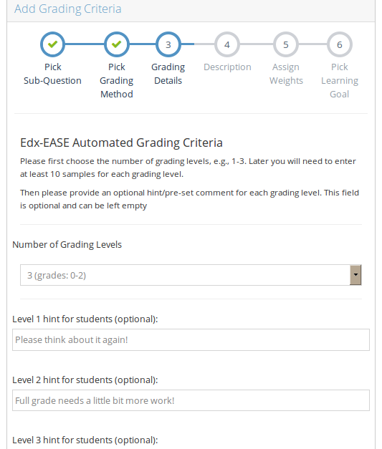
Create Criteria (1-3)
… Specify the question to grade, grading method, and automatic hints.
Notes:
0.5 min
Explain how data is collected

Slide 15
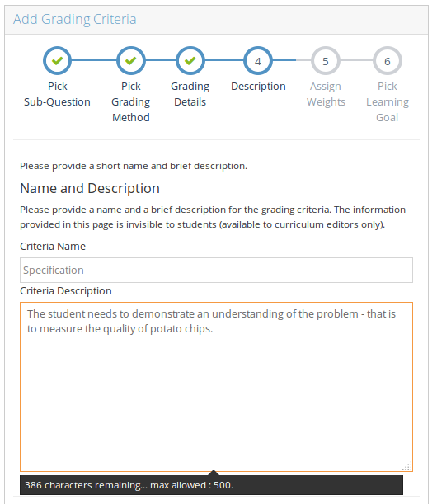
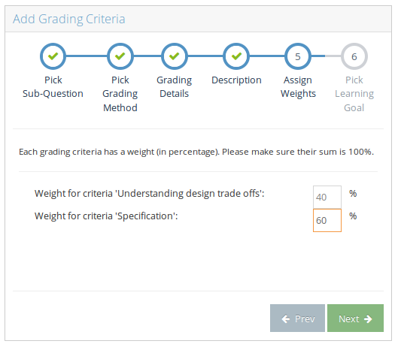
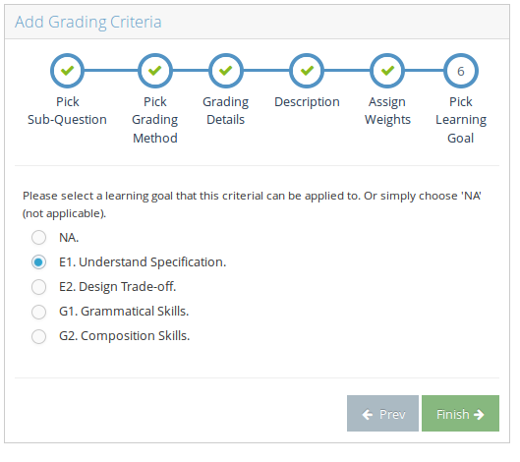
Create Criteria (4-6)
… Specify the weight and learning outcome goals associated.
Notes:
0.5 min
Explain how data is collected

Slide 16
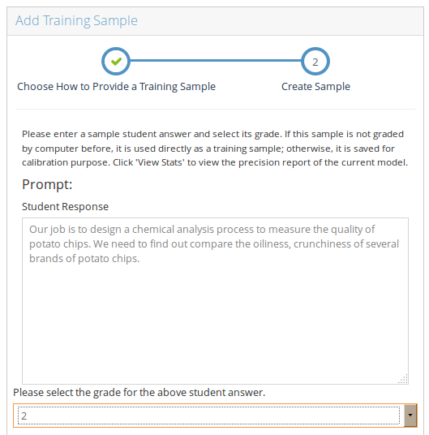
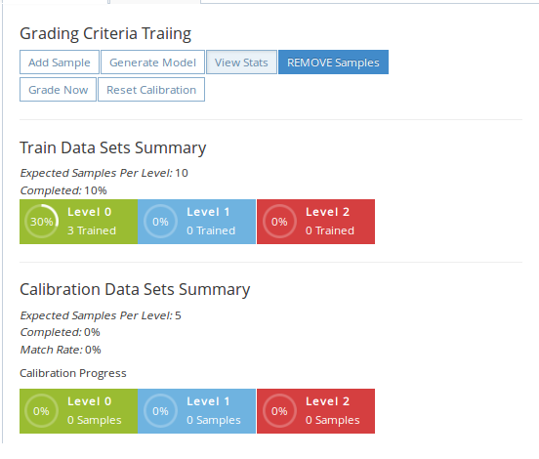
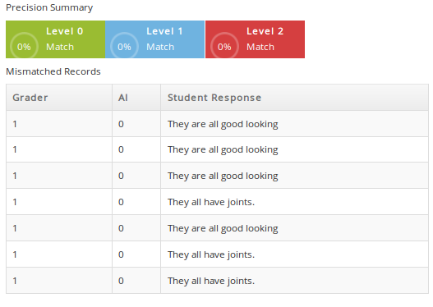
Train Criteria
… Each grading level needs at least 5 to 10 samples.
Notes:
1 min
Explain how data is collected

Slide 17
Behind Training
Feature Extraction
Model Generation
Prediction Using Model
Notes:
1.5 minutes
Behind the training, actually there are lots of things going go. Features are extracted from the student answer first. For example, length of the answer, rate of misspelling and grammatical errors, some simple semantic analysis to see whether the answer is related to the topic context. Then, a vector of these feature scores are fed to an array of classifiers generated by machine learning and the final score is generated by an voting algorithm.

Slide 18
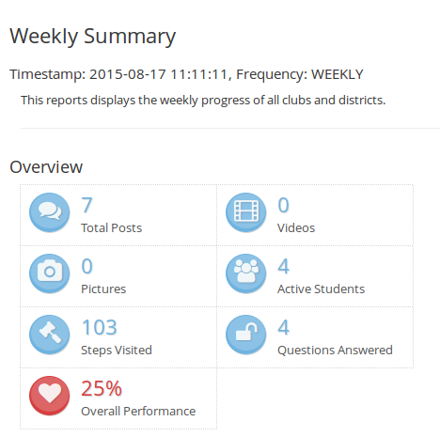
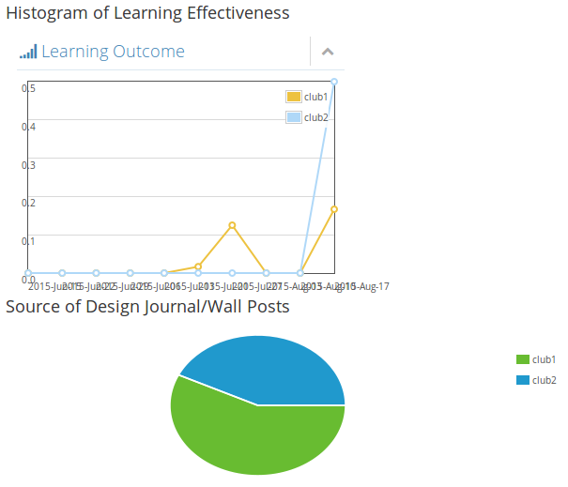
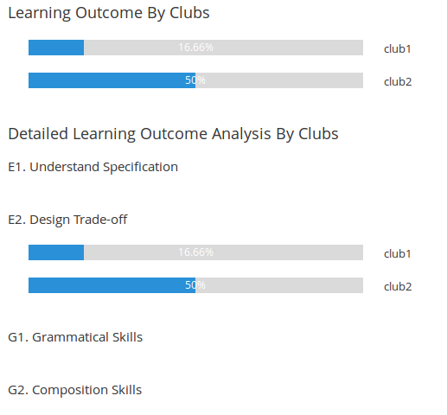
Learning Outcome Reports
… Grades summarized from indicators
Notes:
1 min
Based on the learning data and assessment results generated by auto-grading. The system can generate learning outcome reports for educators.
Screen 1: summary of student activities.
Screnn 2: histograms of learning outcomes by aggregating scores.
Screen 3: since there are a lot of concurrent sessions using the same curriculum, we can compare the performance of different sections.
Module 2: 10 min
Part II: 12 min
25.5 min now

Slide 19
Major Challenges
Extensibility
Scalability
Rapid Prototyping
Notes:
1 min
Now we are going to look at the system from the point view of software engineers.
Given the fast evolving nature of learning theories and we have so many features to implement, the first question is how can we make the system extensible? This is a traiditonal millions of dollar question in the practice of software architecture.
Another direction we are looking at is the scalability – that is when the number of users grow, how can we make the system scale? The ideal case is that the performance of the system should grow linearly with the hardware resources given.

Slide 20
Addressing Extensibility
WISEngineering
Berkeley WISE
Presentation Tier: JS
Researcher Portal
Desktop Portal
Mobile Portal
Logic Tier: JavaEE Servlets
Report Builder
Instant Feedback
Inter-Server
Behavior Track
Design
Journal
Video Process
Avatar System
Auto Grader
Data Tier: MySQL DB (User, Session Data)
Extra Data: Avatar; Grading; Reports …
Notes:
1 min
This slide shows the architecture of the WISEngineering system.
On the left: Berkley wise: typical 3-tier web app (data tier, logical tier, and presentation tier).
On the right: additional components of WISEngineering. Extra data, extra servlets and user portal are developed separately, detached from logical layer.
Note: we provide 3 portals: researcher portal, desktop portal, mobile portal.
The design goal is to minimize the tight coupling of components.

Slide 21

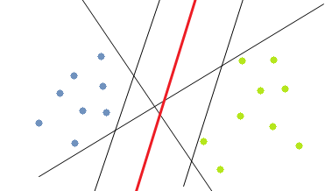
Hybrid Grader (Extensibility)
Goal: Extension with New Machine Learning Algorithms
Q: “What’s design trade-off?”
A: “You’re my favorite teacher. I want an A!”
G: 0
classifier
Notes:
0.5 min
As another example of the extensibility, let’s look at how automated grader is completed. The goal is to be able to plug in any machine learning algorithms to prove the precision of the hybrid grader.
Consider the auto-grader, it is essentially a blackbox of classifiers. Given the question, a student ansewr and human grader assigned grader. We want to generate a classifier which assigns grade for any submitted student answerw.

Slide 22
Variety of Feature Sets & Algorithms
K-Nearest Neighbor
Support Vector Machine
Neural Network
Mis-spelled words
Answer Length
Semantic relation
Grammar Error
Notes:
0.5 min
There are a variety of features and algorithms that we can use, from vector machine, neural network

Slide 23
Stacked Generalization [Wolper’92]
k-NN Arbitrator
Edx EASE
Grader
User Behavior Grader
Keyword Search Grader
Notes:
0.5 min
The idea of our algorithm is to structure all graders in two layers. The bottom layer is a number of graders, each with pros and cons. The upper layer is an arbitrator, which you can regard it as a voting algorithm that aggregates the votes of scores.

Slide 24
Hybrid Grading
Edx EASE
Grader
2
Q: “What’s design trade-off?”
User Behavior Grader
k-NN
Arbitrator
2
A: “You’re my favorite teacher. I want an A!”
Keyword Search Grader
0
Notes:
0.5 min
When a student answer comes in, each grader generates its own score and the uppler layer grader picks the best (because it was trained in advance).

Slide 25
Achieving Scalability
Load Balancer
Distributed Atomicity
Cluster
Robustness
Cloud Service
Notes:
1 min
Another big challenge we are facing is the scalability and system performance.
The main approach we use here are special clusters for specific services, load balancers, and take advantage of existing cloud services
For example, we use Google cloud drive for processing burst of video clips submitted by students when they are working on the engineering labs.
A simple load balancer is used to redirect the video submission traffic to a loosely coupled local cluster server for pre-processing first. Video clips are compressed and submitted at the backend to Google youtube cloud.
Another example is to provide instant grading service to learners. This uses a separate Hadoop cluster.

Slide 26

Instant Grading Service (Scalability)
Mobile Portal Submits Cross-Domain AJAX
Grading Server Grades
JavaScript Callback to Display Hints
50MB Model File (30 sec Load time)
Each Criteria!
Notes:
1 min
The instant grading works like follows. In the mobile portal, when a student submits the answer. A cross-domain AJAX request is submitted to the instant grading servver. Instant grading server runs the automated grading cluster, get the result and shoots back the answer to the client side.
All looks simple, right? But devils hide in details. Auto-grader model files are huge, ranging between 10MB to 50MB RAM resource and loading one will take as long as 30 seconds. Now, we have more than 20 projects running, each come with at least 10 assessment steps, each step come with multiple grading criteria. Because some graders need “atomic” access of temporary local files, they cannot interfere with each other. You simply cannot get current running of the same grader. This determines that we need multiple cluster nodes for hosting all these graders.

Slide 27
Instant Grading Cluster
Service Portal
HDFS
(Classifier Model, Training Samples, …)
Cluster Node 1
Web Portal
Grader Pack (Q1)
Zookeeper
Grader
Process
Shepherd
Service Manager
Job Dispatcher
/
Q1
Q2
Q3
Classifier Model
Job Data
Grader Watcher
Grader Pack1
Grader Pack2
connStr
dataPath
Grader Pack (Q2)
Notes:
Explain the idea of instant grading cluster: 7 min
This slide shows the sophisticated architecture of our instant grading cluster, which is built mainly using a Hadoop system on vmwere sphere center.
Service portal: consists of several live web applications, such as a web portal which accepts grading request. There is a job dispatcher, which dispatches the job to computing nodes.
The HDFS system stores classifier model, training data and there are background processes copying data back and forth between HDFS and the local file systems of each node.
The Zookeeper is used as a central directory of services. It records the location of each grader instance, whether a grader instance is alive or running or executing jobs or free. It also provides distributed mutual exclusion control to avoid data collision.
On each of the cluser node, each grader instance is further “monitored” or managed by a shepherd process, which does the mashalling and unmashing of data and if necessary restarts the grader process when it’s not responsible. The central service can also send commands to shephered process to temporarily stop/restart a grader process based on the statistics of user characterics. For example, requests to graders belong to the same learning module usually come in bursts. Then related graders could get restarted when graders of the same project is invoked. Similarly, they are put to hibernating state when no requests come in.
Part III. 13.5 min
40 min now

Slide 28
Future Research Directions
Browsing History
Page Scrolling
Course Work
Keyboard Activities
Personal Profile
Mouse Activities
Notes:
1 min
The huge amount of data recorded by online learning systems allows infinite research opportunities.
A typical online learning system can record a lot of information: student activities, student coursework, browsing history, topics read, academic performance, finer details can be recorded such as: mouse scrolling rate (which can be used to predict the eye focus on the page), key stroke frequency

Slide 29
New Directions with Big Data
Behaviorism
Learning
Theories
Cognitivism
Constructivism
Hypothesis
Develop Testable Predictions
Gather Data
Develop Theories
Notes:
1.5 min
The vast amount of data, combining with the big data analysis, provides numerous opportunities in educational research.
One promising direction is the learning model discovery.
In the past, people propose learning models, verify the models and proves the models using data. Now, with the vast amount of data available, we can use model extraction and data mining to discover new learning model and theories.
From the system engineering point view, how to support efficiently store, classify, tag, and query of data are always the traditional and fruitful areas of computing.

Slide 30
Media Reference:
[1] M. Lahanas, Education in Ancient Greek, http://www.mlahanas.de/Greeks/EducationAncientGreece.htm
[2] historyforkids.org, Roman Schools, http://www.historyforkids.org/learn/romans/people/school.htm
[3] China Travel Depot, Chinese Ancient Education, http://www.chinatraveldepot.com/C207-chinese-ancient-education
[4] ReturnOfRings, Why is American still using Prussian System, http://www.returnofkings.com/64892/why-is-the-united-states-still-using-the-prussian-education-system
[5] Chesapeake.edu, 19th Century Education, http://www.chesapeake.edu/Library/EDU_101/eduhist_19thC.asp

Slide 31






Questions
Notes:
Slide from windows template

