Slide 1

WISEngineering Massive Online Learning & Social Computing
X. Fu, J. Chiu, M.D. Burghardt
Notes:
1.5 min
The focus of the tutorial will be a combination of social computing and massive online learning.
We will first do a case study of how social computing and massive online learning are integrated with a traditional web based
Learning management systems. This is interesting to us because we have so many new ideas, learning theories emerging recently.
It is interesting to see, from the view point of engineers, how we could rapidly implement learning theories and brace new technolgoies
by enhancing existing learning platforms.
Then based on it, we’ll look at the exciting new research problems and directions that are available to social computing researchers, educators, and researchers in a variety of computing research fields.

Slide 2
Outline
Introduction
Research Problems
Case Study: WISEngineering
System Features
Achieving Scalability & Extensibility
Future Directions

Slide 3
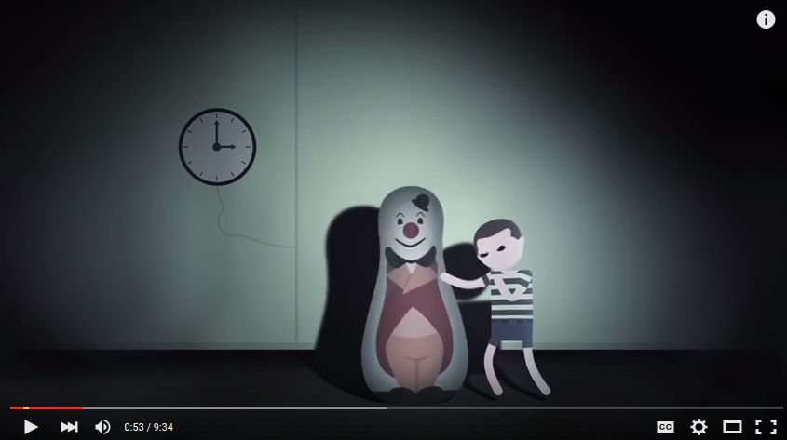
Hank Green, The Bobo Beatdown. Referneces: [1.2]
Notes:
1.5 min
Start the talk with Bandura’s experiment – play til 1 min + 22 sec.
Comments Key Points:
Social media assisted learning has its theory well established 40 years before its invention!

Slide 4
Social Learning (Bandura 1977)
Personal Factors
Behaviors
Environment
Knowledge
Attitudes
Community Impact
Influence on Others
Skills
Self-efficiency
References: [3,4]
Notes:
1.5 min
It is interesting that well before the invention of Internet and social computing, the theory of social learning has been well established by Albert Bandura in 1977.
Brief take away of theory:
Learning is not purely behavioral, it happens in a social context
Learning is a cognitive process where learner observes the models from the environment and the learning is enhanced by the reinforcements from the environment.
Leaner is not a passive information receiver, Cognition, environment and behavior may influence each other

Slide 5
Applications of Social Learning Theory
Vicarious Learning
Enactive Learning
Cognitive Modeling
Notes:
0.5 min
From the 1970’s, many learning theories stem from the social learning theories and are widely populated in the education fields, Examples include enative learning, vicarious learning, cognitive modeling and self-directed training.

Slide 6
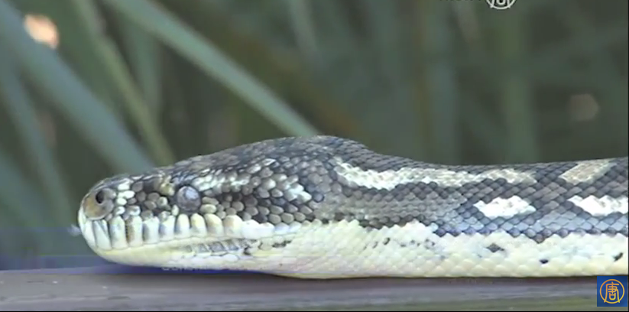
Applications of Social Learning Theory
Vicarious Learning
Enactive Learning
Cognitive Modeling
References: [5]
Notes:
1.5 min
For exapmle, the most amazing application is the vicarious learning – conquer your fear of snakes and catch the snake by hand? How long do you think you can do it? 5 one hour session by vicarious learning – that is by observing a once snake phobia catching snakes, you can also do it!
In the past century, researchers in education and psychology have successfully established a solid foundation of social learning: environment or more specifically a good learning community plays a central role in learning. The feedback you receive from your peers, teachers can greatly shape your learning!

Slide 7







Anything Changed by Social Computing?
Notes:
0.5 min
Now the questions is: have things been changed by social computing? What difference does it make when you have blogging, google docs, slideshare and Linkedin?

Slide 8

Notes:
1 min
The key difference is that: with the ever growing Internet and social networking applications, your learning community is no longer a 30 student class. You could have millions of the learners with the same question, same puzzles, and similar feelings of achievements on learning something! The social networking apps have enabled you to work on analzying a malware sample with someone in Africa!

Slide 9

Current Practice
“Learning 2.0” by (European Commission)
Use Existing Tools
Customized Social Platforms
Supply/Generation of Learning Materials
Knowledge Exchange
Subject Skills
Motivation and Personal Empowerment
ELGG (Social Network Engine)
Reference: [6,7]
Notes:
0.5 min
A group of European Commission has performed a thorough study of applications of social computing in education recently, they have examined the typical usage of social media computing tools in higher education and provided learning data for analyzing the effectiveness of various applications of social media.

Slide 10



Generation of Materials
Video & Audio Learning Materials
Accessible on Mobile Devices
Reference: [6]
Notes:
0.25 min
For example, social media tools have been widely used in higher education for supplying and generating learning materials. Typical examples include podcasting, youtube, and voice thread.

Slide 11



Knowledge Exchange
Communication
Reflection
Scaffolding Knowledge
Reference: [6]
Notes:
0.25 min
Blogging, wiki, twitter have been frequently used for knowledge exchange, for students to commenting, reflection during the learning process

Slide 12
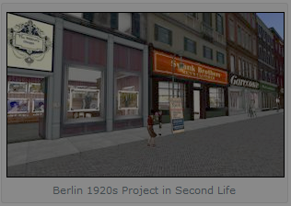

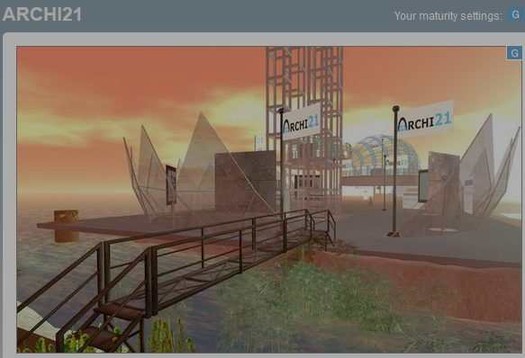
Building Subject Skills
References and Image Sources: [8,9,10]
Notes:
0.25 min
3-d virtual reality like 2nd life has been widely used in
architecture, geography and history courses

Slide 13



Motivation and Personal Empowerment
Collaborative Editing
Building Confidence
Promoting Engagements
Reference: [6]
Notes:
0.5 min
Multiple studies shows that engage students in supporting and hosting learning materials increases their confidence and motivate them active learner and peer teacher. Also social networking tools such as Linkedin and Twitter have been widely used in classes for building a learning community and share and exchange resources.
ELGG: web apps that allow a variety of plug-ins such as podcasting, used by many oragnizations for organizaing special social networks, such as the wiley for building a network of faculty and staff members to network and share resources.

Slide 14
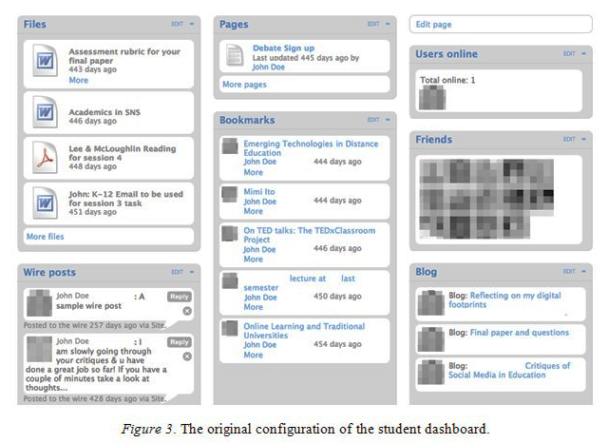
Customizable Social Computing Platforms
ELGG (Open Source Social Networking Engine)
Collaborative Editing
Social Bookmarks
Blogs
Image source: user experience report by G. Veletsianos and C. C. Navarrete[11]
Notes:
0.5 min
There are also customizable social computing platforms such as ELGG available for business and educational purposes. ELGG provides modular buliding blocks such as collaborative editing, social bookmarks, blogs.
The user experiences, like many other social media apps in education, are mixed. (lack of student active participation etc.)

Slide 15


Notes:
0.1 min
So, the education community has achieved quite a lot. What is the next step?

Slide 16





MOOCs
Massive Open Online Courses
Notes:
0.25 min
I think the next wave is the massive open online courses.

Slide 17
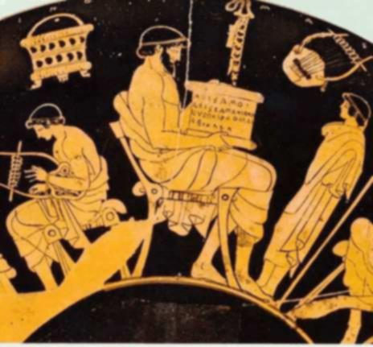
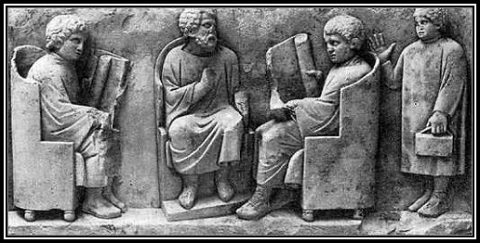

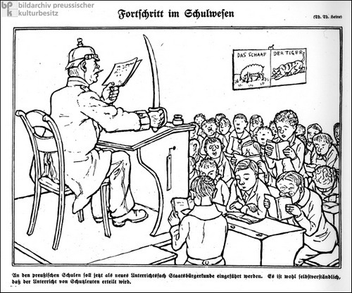
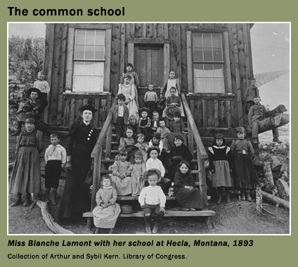
Accessible & Cost & Technology …
Greek
Rome
China
Image sources: [12, 13, 14, 15, 16]
19th Century Prussian
19’th Century U.S
Notes:
1.5 min
If you look at the history of education, from ancient Greece, Rome to India and China, there are numerous waves of education reforms. Most of them, the goal is to make education more accessible and to lower its cost. These education reforms usually lead to drastic social changes and they are accompanied by technology renovations of the time.
For example, the two kids in the picture of Rome must be very rich – because they have books. For most of students in a Roman school, dictation is a must because there’s no books. Similarly, education starts to reach about 1 percent of population in China about one thousand years ago because of the invention of printing techniques (wooden movable type)

Slide 18
MOOCs Platforms
Learning Analytics
Grading
Wiki
OpenEdX
Moodle
Canvas
Docebo
Saikai
Blackboard
User Management
RSS Feeds
Content Delivery
Team Collobaration
Digital Certificates & Badging
Social Sharing
Notes:
1.5 min
With the wave of massive open online education, a variety of learning management systems or so called online education systems are thriving. From the traditional web based systems such as Blackboard, open source and modular system such as Moodle to the more recent OpenEdX.
These platforms embraces new technologies and platforms such as mobile app, social media, learning analytics, automated grading. They open numerous opportunities for educators and researchers.
Part I. 13.5 min now

Slide 19






Case Study: WISEngineering
Notes:
0.5 min
We would like to introduce WISEngineering, yet another learning platform that embraces social media and massive online learning. It serves as a case study of the fast evolving learning management system.
----------------------------------------------------
Slide – animiation from Microsoft standard template -> pictures

Slide 20

Interesting Research Problems
Address Lack of Feedback of Massive Online Learning?
Rapid Prototyping of a Learning Theory?
Achieve Scalability & Extensibility?
Notes:
1.5 min
Why WISEngineering ? As an example of the fast evolving online learning platforms in the social media era.
We are interested in several questions:
1> How can educators take advantage of social media?
2> How do we improve the learning experience?
3> How quickly can a learning theory can be implemented?
4> Scalability and extensibility?
We’d like to drill into the design and implementation details of the system and look at how we are able to build a low cast and fast prototyping learning platforms using an open architecture.

Slide 21
WISEngineering Architecture
Outcome Analysis
Auto-Grading
Mobile Portal
Berkley WISE
Notes:
1 min
Just explain the idea of built upon Berkley WISE, we add the social media features into

Slide 22
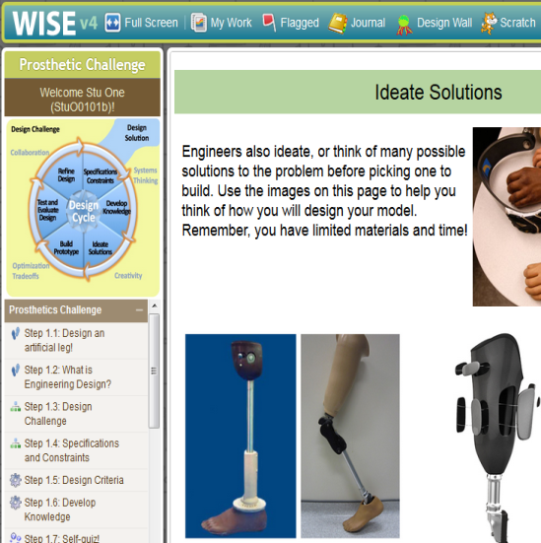
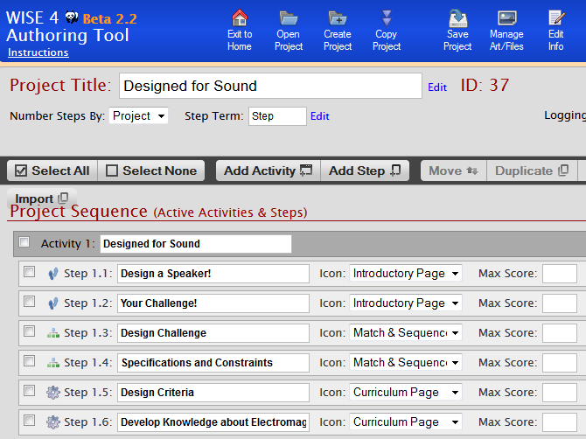
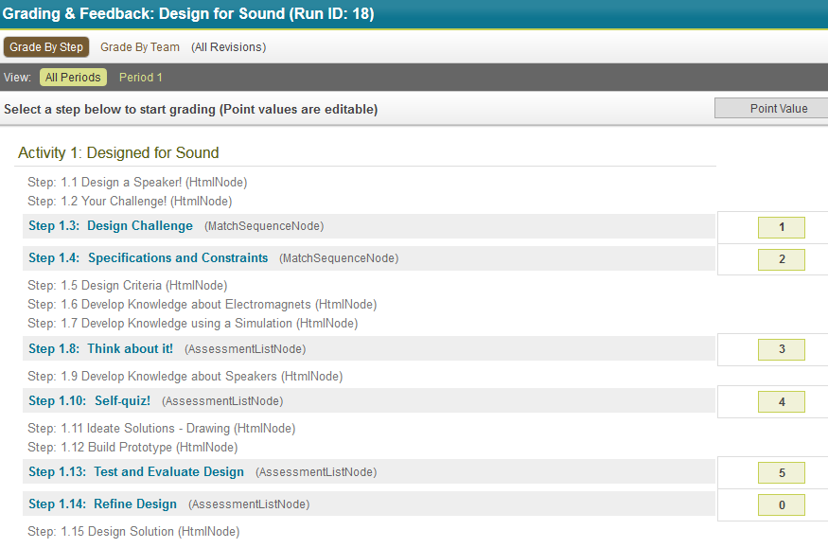
Berkley WISE
-- Web Based Inquiry Science Environment
Notes:
1.5 minutes
BerkleyWISE – provides traditional courseware management
[1] contents delivery
[2] course authoring
[3] evaluation
→ Desktop Version

Slide 23
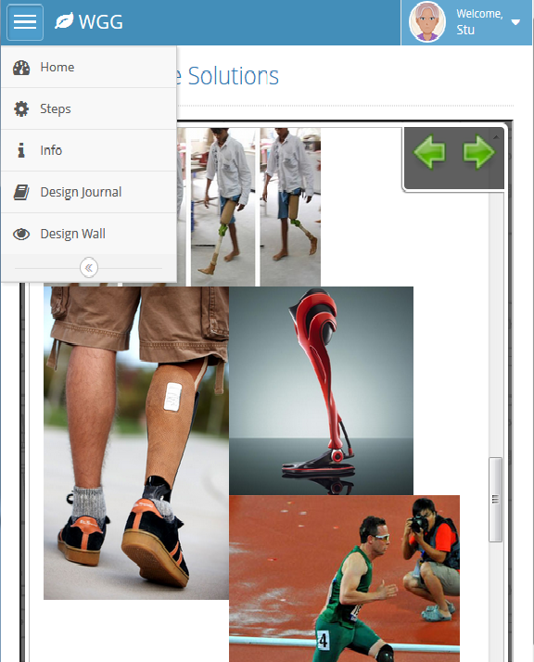
WISEngineering Features
Mobile Portal: Chrome Web App on 7’ Android Device
Notes:
0.25 min
WISEngineering Portal

Slide 24
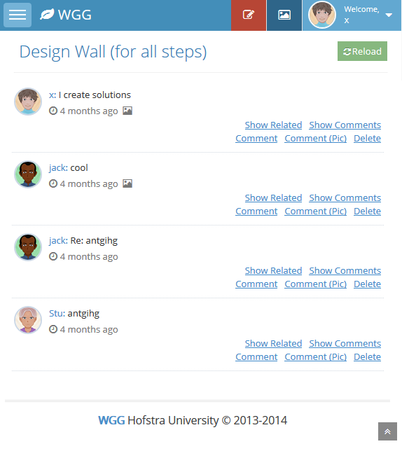
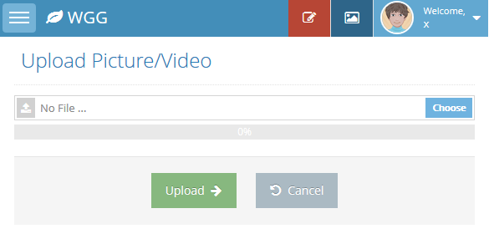
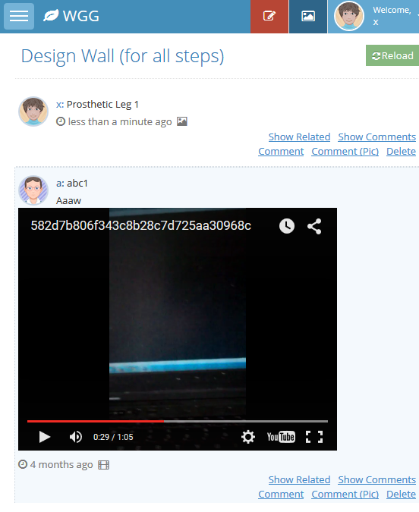
Notes:
A couple of more screen shots (0.25 min)
Design journal, design wall, video post

Slide 25
Automated Grading
Define
Learning
Outcome
Goals
Train
Machine
Learning
Data Set
Analysis
Outcome
Reports
Notes:
1.5 minutes
Three steps in learning outcome analysis
[1] define learning outcome goals
[2] train the machine learning algorithm
[3] generate the learning outcome reports

Slide 26
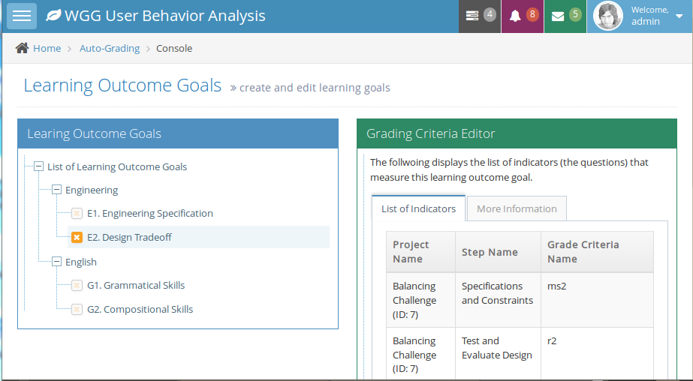
Learning Goals
Notes:
0.75 min
Explain how to define learning goals, they will be later associated with the assessment questions

Slide 27
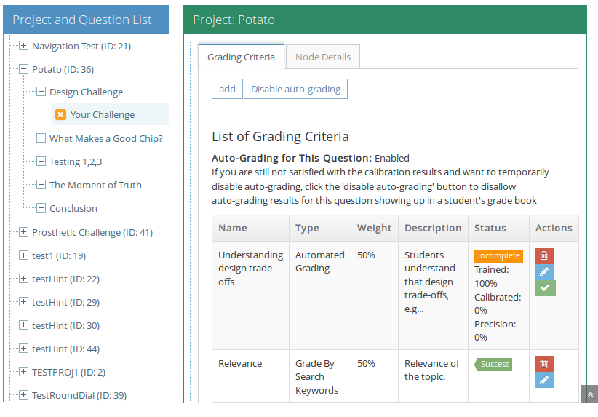
Training Criteria
Notes:
1 min
Explain how to define training critera
1> each question can have multiple criteria, reflecting different learning goals
2> each criteria can be graded by a specific method.

Slide 28
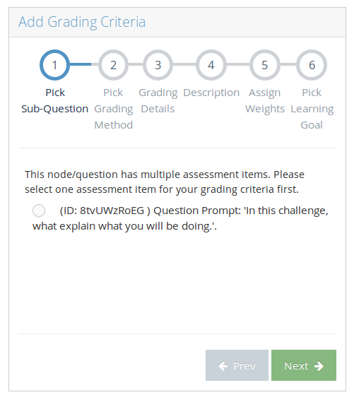
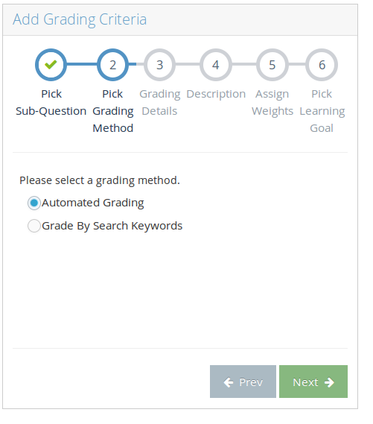
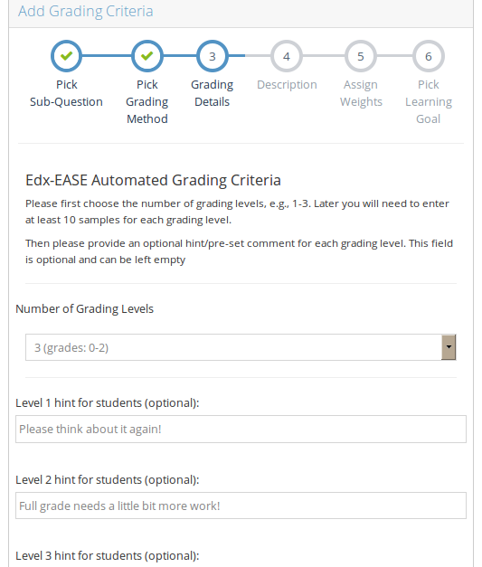
Create Criteria (1-3)
… Specify the question to grade, grading method, and automatic hints.
Notes:
0.5 min
Explain how data is collected

Slide 29
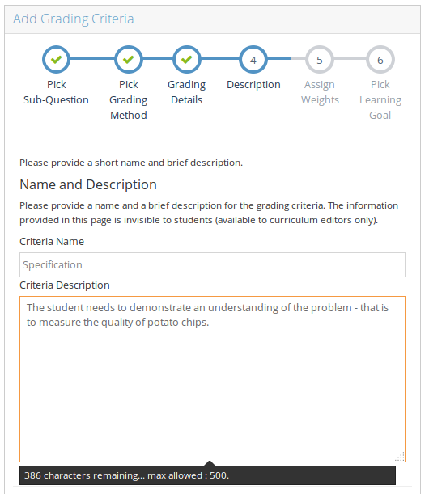
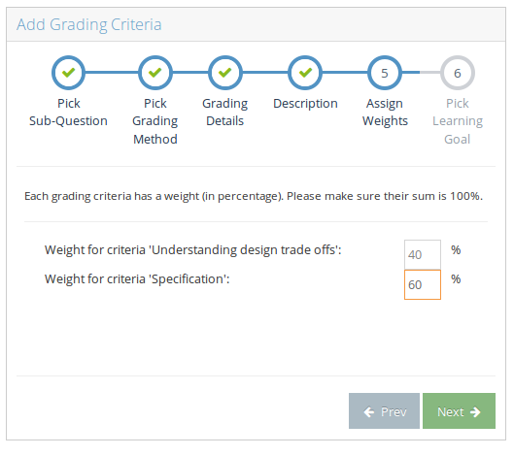
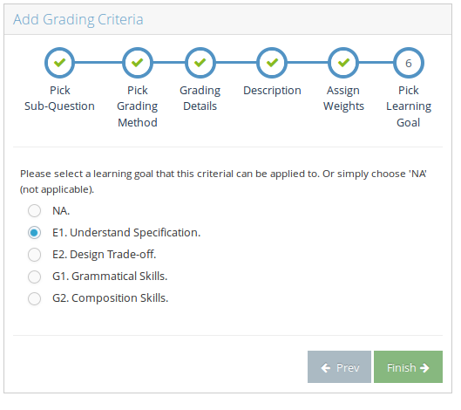
Create Criteria (4-6)
… Specify the question to grade, grading method, and automatic hints.
Notes:
0.5 min
Explain how data is collected

Slide 30
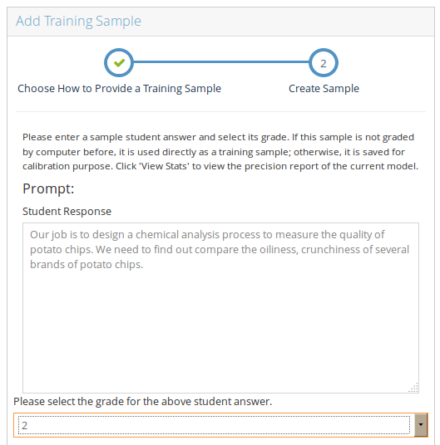
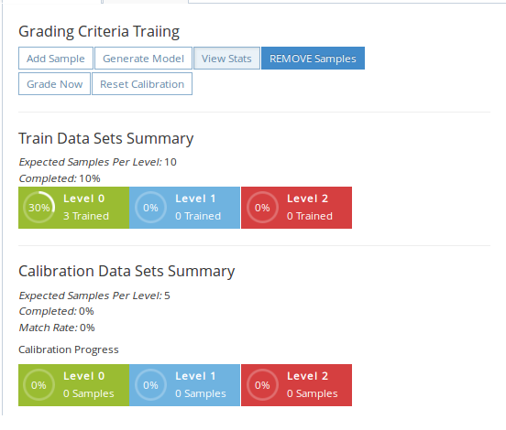
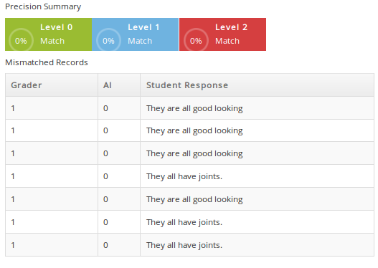
Train Criteria
… Each grading level needs at least 5 to 10 samples.
Notes:
1 min
Explain how data is collected

Slide 31
Behind Training
Feature Extraction
Model Generation
Prediction Using Model
Notes:
1.5 minutes
Explain: what features do we extract (word length, grammar analysis, …)

Slide 32
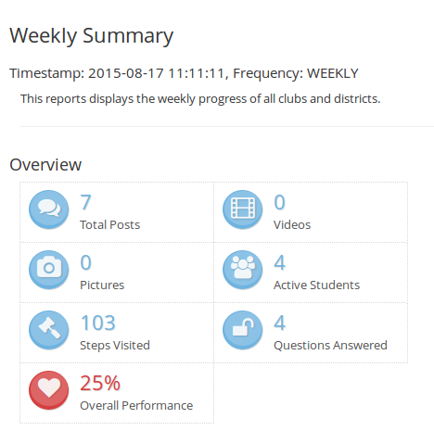
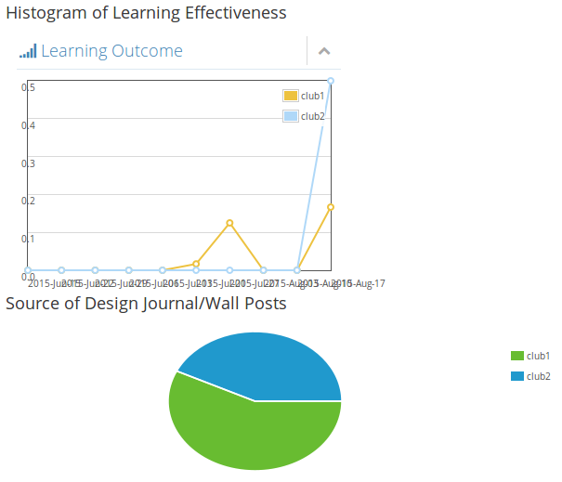
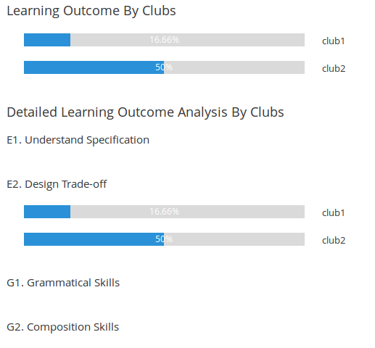
Learning Outcome Reports
… Grades summarized from indicators
Notes:
1.5 min
Explain how data is collected
Part II: 12 min
25.5 min now

Slide 33

Devil’s in Detail

Slide 34
Major Challenges
Extensibility
Scalability
Rapid Prototyping
Notes:
Briefly introduce the major challenges
1.5 min

Slide 35
Addressing Extensibility
Open Arch.
Key Distribution
Loosely Coupled
Fail Safe
Service Oriented
Hybrid Machine Learning
Notes:
1.5 minutes
Explain the key ideas related to addressing extensibility

Slide 36
Software Stack (Extensibility)
WISEngineering
Berkeley WISE
Presentation Tier: JS
Researcher Portal
Desktop Portal
Mobile Portal
Logic Tier: JavaEE Servlets
Report Builder
Instant Feedback
Inter-Server
Behavior Track
Design Journal
Video Process
Avatar System
Auto Grader
Data Tier: MySQL DB (User, Session Data)
Extra Data: Avatar; Grading; Reports …
Notes:
2 min
Achieving extensibility:
Servlets built centered around the original WISE system. Most information accessed through servlets. New functionalities warpped as web services

Slide 37

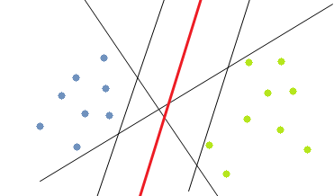
Hybrid Grader (Extensibility)
Goal: Extension with New Machine Learning Algorithms
Q: “What’s design trade-off?”
A: “You’re my favorite teacher. I want an A!”
G: “What’s design trade-off?”
classifier
Notes:
1 min
Hybird grader as another example, out goal: extend it with new machine learning algorithm

Slide 38
Variety of Feature Sets & Algorithms
K-Nearest Neighbor
Support Vector Machine
Neural Network
Mis-spelled words
Answer Length
Semantic relation
Grammar Error
Notes:
1 min: many different features and algorithms

Slide 39
Stacked Generalization [Wolper’92]
k-NN Arbitrator
Edx EASE
Grader
User Behavior Grader
Keyword Search Grader
Notes:
1 min

Slide 40
Hybrid Grading
Edx EASE
Grader
2
Q: “What’s design trade-off?”
User Behavior Grader
k-NN
Arbitrator
2
A: “You’re my favorite teacher. I want an A!”
Keyword Search Grader
1
G: “What’s design trade-off?”
Notes:
1 min
Simple process, the Central arbitrator is previously trained.

Slide 41
Achieving Scalability
Load Balancer
Distributed Atomicity
Cluster
Robustness
Cloud Service
Notes:
1.5 min
Overview: scalability -> basic idea: cluster
Issues: assure distributed atomict,
Give example: Google video processing & cloud

Slide 42

Instant Grading Service (Scalability)
Mobile Portal Submits Cross-Domain AJAX
Grading Server Grades
JavaScript Callback to Display Hints
50MB Model File (30 sec Load time)
Each Criteria!
Notes:
1 min

Slide 43
Instant Grading Cluster
Service Portal
HDFS
(Classifier Model, Training Samples, …)
Cluster Node 1
Web Portal
Grader Pack (Q1)
Zookeeper
Grader Process
Shepherd
Service Manager
Job Dispatcher
/
Q1
Q2
Q3
Classifier Model
Job Data
Grader Watcher
Grader Pack1
Grader Pack2
connStr
dataPath
Grader Pack (Q2)
Notes:
Explain the idea of instant grading cluster: 2 min
Part III. 13.5 min
40 min now

Slide 44


Notes:
0.5 min
As the last part of the talk, we will talk about some of the future directions of learning management systems for massive online learning + social computing. There are many interesting research problems for a variety of computing research fields.
Animation from Microsoft template. PPT -> File -> New -> Pictures

Slide 45
I. Knowledge Engineering
Variable
Integer Arithmetic
Sequential
Expression
Boolean Logic
Loop
Assignment
Statement
Branch
Ontology
Semantic Web
Notes:
1 min
One of the interesting direction is knowledge engineering, and the ontology and semantic web technology can be directly applied here.
Just like social network – it’s a network of human being. A course or an academic program can be modeled as a network of knowledge fields and skill sets. There are relations between these knowledge fields and skill sets and it’s a perfect topic for ontology modeling and semantic analysis.

Slide 46
Applications of Knowledge Engineering
How we teach?
How we evaluate?
How does industry interpret a degree?
Notes:
0.5 min
Application of knowledge engineering may have deep influence in how we teach, how we evaluate and assess students, and how we provide the service to students in the future. Here I will take teaching as an example.

Slide 47





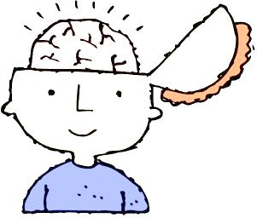
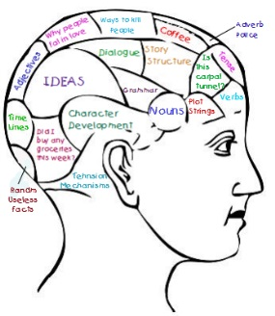

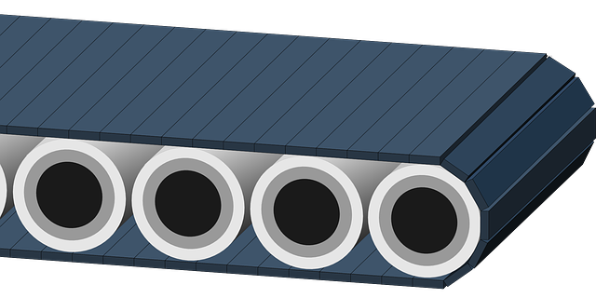
Agile “Manufacturing” of Degree Recipients
Notes:
0.5 min
Think about the academic institutions of an assembly line. (I know immediately that some of you might already hate it!) Professors are the workers on the line. Each of us has a special set of skills, and our job is to put a set of parts (the knowledge and skill sets) into our the mindset of our students.

Slide 48
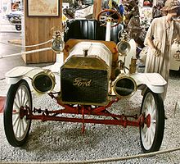
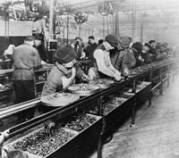
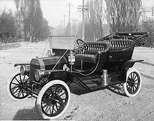
Agile “Manufacturing” of Degree Recipients
Course Broken Down
Teaching Obligation “Out Sourced”
Professors Concentrate on Individualized Coaching
Assisted by Massive Online Learning Management System
Image source: [17]
Notes:
2 min
Recall Why Henry Ford’s assembly line and model T was so successful in the early 20’th century, which made the united states the super industrial power in the world? Henry ford structured the assembly line so that the workers on the assembly line needs to know only a small part of the entire product and only needs to do very very well on that particular part.
Now come back to the assembly line of college degrees. At this moment, the basic unit (or a step) of the assembly line is a course, taught by a professor. With the massive online education system and social computing, it might be possible to further split a course centering around further refined steps, centered around specific knowledge areas and skill sets. The emerging technology, for example, adaptive testing at least allows two possibilities here: [1] teaching of a specific knowledge area can be further specialized and taught by the world expert in that area and achieve economies of scale, [2] even for the same knowledge area, based on the apptitude/existing skills of students, different modules or content suppliers could be chosen.
This may even change the role of a professor, from the “vendor” of knowledge to the real “assembler” of knowledge. By out sourcing some of the teaching obligations, we concentrate or care more about the mindset (real knowledge and skills) of a student, and choose the individualized coaching/online teaching materials for the students. This advising/coaching process can be further automated by the tools available in learning management systems, e.g., semantic analysis and cognitive modeling can be used to ‘automatically’ recommend topics to study and materials to read.

Slide 49
II. User Behavior and Big Data Analysis
Browsing History
Page Scrolling
Course Work
Keyboard Activities
Personal Profile
Mouse Activities
Notes:
1 min
The huge amount of data recorded by online learning systems allows inifinte research opportunities.
A typical online learning system can record a lot of information: student activities, student coursework, browing history, topics read, academic performance, finer details can be recorded such as: mouse scrolling rate (which can be used to predict the eye focus on the page), key stroke frequency

Slide 50
New Directions with Big Data
Behaviorism
Learning
Theories
Cognitivism
Constructivism
Hypothesis
Develop Testable Predictions
Gather Data
Develop Theories
Notes:
1 min
The vast amount of data, combining with the big data analysis, provides numerous opportunities in educational research.
One promising direction is the learning model discovery.
In the past, people propose learning models, verify the models and proves the models using data. Now, with the vast amount of data available, we can use model extraction and data mining to discover new learning model and theories.
From the system engineering point view, how to support efficiently store, classify, tag, and query of data are always the traditional and fruitful areas of computing.

Slide 51
Some Interesting Questions
Is Calc I Indicator of Student’s Success in CS?
Can Social Friend Circle Predict Behaviors of Learning?
Identify Students with Similar Learning Barriers?
Will Inclusion of Buffer Overflow Lab Improve Understanding of Call Stack?
Notes:
2 min
I will enumerate some simple examples of big data and statstical analysis can help to discover some learning models or theories. For example, in typical believe among computer science professors is that Calculus is an effective indicator of a student’s future academic success in computer science major. This can be easily verified with the huge amount of data collected by a learning system.
With the “social networking” information of a student collected, we could predict their behaviors based on their personal “social network”.
----
In addition to the learning model discovery, we could take advantage of big data analysis for providing individualized help for students. For exapmle, we can identify students with similar learning bariers (e.g., having difficulty with understanding the parameter passing in functions).
Another immediate and practical application of big data is to help instructors to refine the curriculum materials. For example, using large quantity of data we could answer questions like: If we include the practical example of buffer overflow, would that help a student’s understanding of function parameter passing?

Slide 52

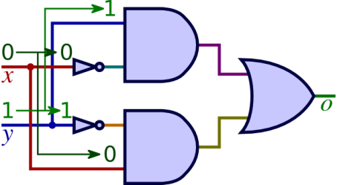
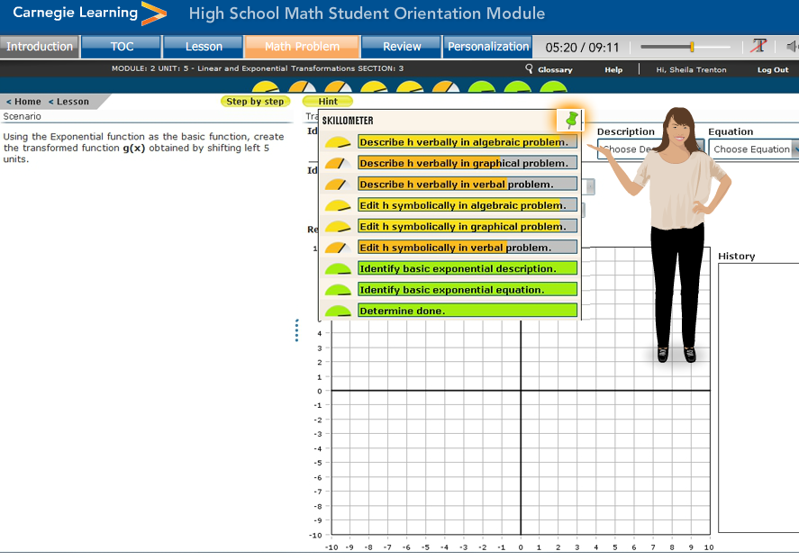
III. Cognitive Modeling
ACTR
SOAR
…
Symbolic
Cognitive Model
Neural Network
CPG
…
Connectionism
Cognitive Tutoring
Intelligent Tutoring Systems
Image Src: [18]
Notes:
1.5 min
Another interesting area is the application of cognitive modeling.
Cognitive modeling is about to establish a formal model to reasoning about the cognitive function of human branins. In the past, there are many cognitive theories developed, categoried into two types: symbolism and connectionism. For exapmle, the famous ACT-R (Adaptive Control of Thought – Ratinoal) theory has been widely applied in teaching. It is the basis of a famous cognitive tutoring or so called intelligent tutoring system called MathTutor which has been used to adaptively tutor mathematics in thousands of primary and middle schools.
The idea is that, given a sophisticated mission, e.g., to solve a mathematical equation, the mission could be decomposed into more refined or atomic steps. This skill, called “procedural knowledge” in the ACT-R theory, could be actually encoded as a program (in LISP). By observing the behaviors of students, e.g., in solving an equation, the adaptive tutor could measure the mind state of the student and give the right hint and help at the right spot.

Slide 53



Interesting Question
Cognitive Modeling
Social Networking
Notes:
0.1 min

Slide 54




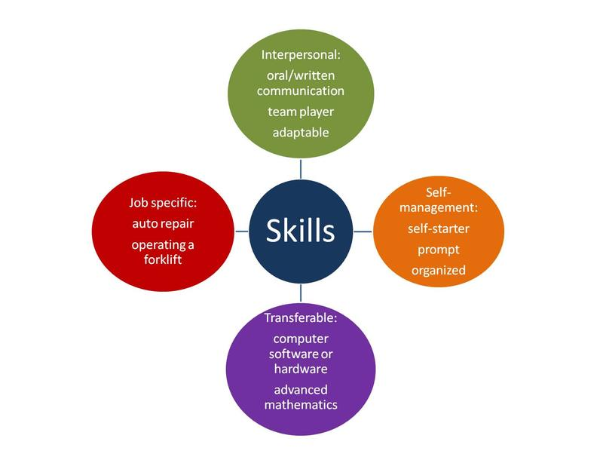
Current LinkedIn Model
degree
Network References
Endorse
Resume
Notes:
0.5 min
Think about the current social networking services like LinedIn. What’s included in a profile of a fresh college graduate?
Degree, resume, connections to references, skill sets and endorsements by references.

Slide 55

Job Match
How does LinkedIn select you for a job?
Notes:
0.25 min
It’s a magic box. Mostly keywords search but also backed up by a ranking of network of endorsed skill sets.

Slide 56
Hybrid Profile
Cognitive Models
Knowledge Body
Social Net of References
Privacy Issues?
Notes:
0.5 min
A better model could be a hybrid model. With one or multiple cognitive models describing the appitude of the applicants, a detailed knowledge body and skill sets (ceritificated by the academic records in each components of the college course work), and backed up by the social net of references. This could describe more precisely the ability of a job candidate.
This induces many interesting problems, e.g., how do we preserve the privacy of user, e.g., allowing the search but do not release the entire profile?

Slide 57
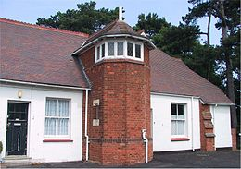
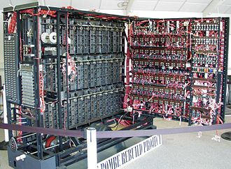

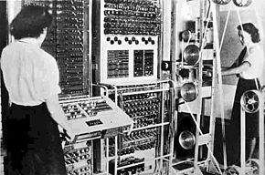
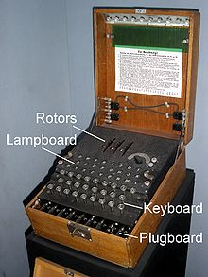

FIN
Image Src: [19]
Notes:
1 min
In the Second World War, when the British tries to break the German code, the team at Bletchley Park comprises all kinds of people: typically code breaker, mathematians, linguisistics, chess chamion, crossword puzzle solver, and even people who read/interpret the ancient Egyptian language on Papyrus. I guess it’s a pretty dawning task to assemble a team like this.
Maybe, in the future, not far from today, with the combination of these fasting evolving techonlgoies such as social computing, big data analysis, cognitive modeling. To assemble a team of code breakers might only need a mouse click.
Module 3: 12.25 min
52.25 min now

Slide 58
References
[1] H. Green, The bobo doll beatdown- https://www.youtube.com/watch?v=128Ts5r9NRE
[2] The bobo doll experiment - - http://www.simplypsychology.org/bobo-doll.html
[3] A. Bandura, Social Learning Theory. Prentice Hall, 1977.
[4] S. McLeod, Bandura – Social Learning Theory, http://www.simplypsychology.org/bandura.html
[5] NTDTV, How to conquer fear of snakes, https://www.youtube.com/watch?v=sIt9AItzD_g
[6] C. Redecker, K. Ala-Mutka, Y. Punie, Learning 2.0 – the use of social computing to enhance lifelong learning, http://is.jrc.ec.europa.eu/pages/EADTUpaperFINAL.pdf.pdf
[7] elgg.org, ELGG Show Case (Wiley Faculty Network), https://elgg.org/showcase/view/1542898/wiley-faculty-network
[8] R. Hollingsworth, Using Second Life in History Classes, https://ukisland.wordpress.com/2013/11/22/history-class/
[9] avatarlange.com, Practice Foreign Language in Second Life, http://www.avatarlanguages.com/freepractice.php
[10] secondlife.org, Arch21 Project, http://secondlife.com/destination/archi21

Slide 59
[11] G. Veletsianos and C. C. Navarrete , Online Social Networks as Formal Learning Environments: Learner Experiences and Activities, International Review of Research in Open and Distributed Computing, 2012. Available at
http://www.irrodl.org/index.php/irrodl/article/view/1078/2077
[12] M. Lahanas, Education in Ancient Greek, http://www.mlahanas.de/Greeks/EducationAncientGreece.htm
[13] historyforkids.org, Roman Schools, http://www.historyforkids.org/learn/romans/people/school.htm
[14] China Travel Depot, Chinese Ancient Education, http://www.chinatraveldepot.com/C207-chinese-ancient-education
[15] ReturnOfRings, Why is American still using Prussian System, http://www.returnofkings.com/64892/why-is-the-united-states-still-using-the-prussian-education-system
[16] Chesapeake.edu, 19th Century Education, http://www.chesapeake.edu/Library/EDU_101/eduhist_19thC.asp
[17] Wiki, Ford Model T, https://en.wikipedia.org/wiki/Ford_Model_T
[18] Carnegie Learning, Cognitive Tutor Software, https://www.carnegielearning.com/learning-solutions/software/cognitive-tutor/
[19] Wiki, Bletchley Park
, https://en.wikipedia.org/wiki/Bletchley_Park#Personnel
[2] Wiki, Enigma Machine, https://en.wikipedia.org/wiki/Enigma_machine

Slide 60






Questions
Notes:
Light Bulb Questions
(Intermediate)
To reproduce the box effects on this slide, do the following:
On the Home tab, in the Slides group, click Layout, and then click Blank.
On the Design tab, in the Themes group, click the arrow next to Colors and then click Oriel.
On the Insert tab, in the Illustrations group click the arrow under Shapes, and then under Rectangles, select rectangle (first row, first option from left).
On the slide, drag to draw a rectangle.
Under Drawing Tools, in the Format tab, in the Size group, click the arrow at the bottom right corner launching the Format Shape dialog box.
In the Format Shape dialog box, select Size in the left pane, under Size and rotate in the right pane set Height to 1.88” and Width to 2”.
Also in the Format Shape dialog box, select Fill in the left pane, and under Fill in the right pane select No Fill.
Also in the Format Shape dialog box, select Line Color in the left pane, under Line Color in the right pane, select Solid Line, and then click the arrow to the right of Color, and under Theme Colors, select Black, Text 1 (first row, second option from left).
Also in the Format Shape dialog box, select Line Style in the left pane, under Line Style in the right pane set Width to 0.25 pt.
Close the Format Shape dialog box.
Select the rectangle. On the Home tab, in the Drawing group, click Arrange, point to Align, and then do the following:
Click Align Left.
Click Align Top.
Select the rectangle. On the Home tab, in the Clipboard group, click the arrow to the right of Copy, and then click Duplicate. Repeat this process three more times for a total of five rectangles.
Select duplicate on right side. On the Home tab, in the Drawing group, click Arrange, point to Align, and then do the following:
Click Align Right.
Click Align Top.
Select all five rectangles. On the Home tab, in the Drawing group, click Arrange, point to Align, and then do the following:
Click Align Top.
Click Distribute Horizontally.
Under Drawing Tools, on the Format tab, in the Arrange group, click the arrow to the right of Group and select Group.
Select the grouped rectangles. On the Home tab, in the Clipboard group, click the arrow to the right of Copy, and then click Duplicate. Repeat this process two more times for a total of four grouped sets.
Select one grouped set. On the Home tab, in the Drawing group, click Arrange, point to Align, and then do the following:
Click Align Center.
Click Align Bottom.
Select all other grouped sets, and also on the Home tab, in the Drawing group, click Arrange, point to Align, do the following:
Click Align Center.
Click Distribute Vertically.
Select all grouped rectangles. Under Drawing Tools, on the Format tab, in the Arrange group, click the arrow to the right of Group and select Ungroup.
To reproduce the video effects on this slide, do the following:
On the Insert tab, in the Media group, click Video, and then click Video from File.
In the left pane of the Insert Video dialog box, click the drive or library that contains the video. In the right pane of the dialog box, click the first video that you want, and then click Insert.
Under Video Tools, on the Format tab, in the Size group, click the arrow at the bottom right corner to launch the Format Video dialog box.
In the Format Video dialog box, select Size in the left pane, under Size and Rotate in the right pane, set Height to 1.88” and Width to 1.99”.
In the Animations tab, in the Animation group, select Play.
Also on the Animations tab, in the Timing group, click the arrow to the right of Start and select With Previous.
On the Home tab, in the Drawing group, click Arrange, point to Align, and then do the following:
Click Align Left.
Click Align Top.
Also on the Home tab, in the Drawing group, click Arrange, under Order Objects, click Send to Back.
On the Insert tab, in the Media group, click Video, and then click Video from File.
In the left pane of the Insert Video dialog box, click the drive or library that contains the video. In the right pane of the dialog box, click the second video that you want and then click Insert.
In the Format Video dialog box, select Size in the left pane, under Size and Rotate in the right pane, and set Height to 1.88” and Width to 1.99”.
In the Animations tab, in the Animation group, select Play.
Also on the Animations tab, in the Timing group, click the arrow to the right of Start and select With Previous.
On the Home tab, in the Drawing group, click Arrange, point to Align, and then click Align Top.
Press and hold CTRL, select second video and second rectangle from top left. On the Home tab, in the Drawing group, click Arrange, point to Align, and then select Align Left or Align Right (depending on which way the video needs to move to match up with rectangle).
Select the second video, on the Home tab, in the Drawing group, click Arrange, under Order Objects, click Send to Back.
On the Insert tab, in the Media group, click Video, and then click Video from File.
In the left pane of the Insert Video dialog box, click the drive or library that contains the video. In the right pane of the dialog box, click the third video that you want and then click Insert.
Under Video Tools on the Format tab, in the Size group, click the arrow at the bottom right corner to launch the Format Video dialog box.
In the Format Video dialog box, select Size in the left pane, under Size and Rotate in the right pane, set the Height to 3.75” and the Width to 4”.
In the Animations tab, in the Animation group, select Play.
Also on the Animations tab, in the Timing group, click the arrow to the right of Start and select With Previous.
On the Home tab, in the Drawing group, click Arrange, point to Align, and then do the following:
Click Align Right.
Click Align Top.
Also on the Home tab, in the Drawing group, click Arrange, under Order Objects, click Send to Back.
On the Insert tab, in the Media group, click Video, and then click Video from file.
In the left pane of the Insert Video dialog box, click the drive or library that contains the video. In the right pane of the dialog box, click the fourth video that you want and then click Insert.
In the Format Video dialog box, select Size in the left pane, under Size and Rotate in the right pane, set the Height to 1.88” and the Width to 1.99”.
In the Animations tab, in the Animation group, select Play.
Also on the Animations tab, in the Timing group, click the arrow to the right of Start and select With Previous.
On the Home tab, in the Drawing group, click Arrange, point to Align, and then click Align Bottom.
Press and hold CTRL, select fourth video and seventeenth rectangle (fourth row, second option from left). On the Home tab, in the Drawing group, click Arrange, point to Align, and then select Align Left or Align Right (depending on which way the video needs to move to match up with rectangle).
Select just the video, on the Home tab, in the Drawing group, click Arrange, under Order Objects, click Send to Back.
On the Insert tab, in the Media group, click Video, and then click Video from file.
In the left pane of the Insert Video dialog box, click the drive or library that contains the video. In the right pane of the dialog box, click the fifth video that you want and then click Insert.
In the Format Video dialog box, select Size in the left pane, under Size and Rotate in the right pane, set the Height to 1.88” and the Width to 1.99”.
In the Animations tab, in the Animation group, select Play.
Also on the Animations tab, in the Timing group, click the arrow to the right of Start and select With Previous.
Press and hold CTRL, select fifth video and thirteenth rectangle (third row, third option from left). On the Home tab, in the Drawing group, click Arrange, point to Align, and then select Align Left or Align Right, and then Align Top or Align Bottom (depending on which way the video needs to move to match up with rectangle).
Select just the video, on the Home tab, in the Drawing group, click Arrange, under Order Objects, click Send to Back.
On the Insert tab, in the Media group, click Video, and then click Video from file.
In the left pane of the Insert Video dialog box, click the drive or library that contains the video. In the right pane of the dialog box, click the sixth video that you want and then click Insert.
In the Format Video dialog box, select Size in the left pane, under Size and Rotate in the right pane, set Height to 1.88” and Width to 1.99”.
Close the Format Video dialog box.
In the Animations tab, in the Animation group, select Play.
Also on the Animations tab, in the Timing group, click the arrow to the right of Start and select With Previous.
On the Home tab, in the Drawing group, click Arrange, point to Align, and then click Align Bottom.
Press and hold CTRL, select sixth video and nineteenth rectangle (fifth row, fourth option from left). On the Home tab, in the Drawing group, click Arrange, point to Align, and then select Align Left or Align Right (depending on which way the video needs to move to match up with rectangle).
Select just the video, on the Home tab, in the Drawing group, click Arrange, under Order Objects, click Send to Back.
To reproduce the text effects on this slide, do the following:
Press and hold CTRL, select rectangles six, seven and eight (second row, first, second and third options from left), then under the Home tab, in the Clipboard group, click the Cut icon.
On the Insert tab, in the Text group, click Text Box, and then on the slide drag to draw your text box in the area you just cut.
Type text, Questions, in the text box, and then select the text. On the Home tab, in the Font group, select Book Antiqua from the Font list, with a Font Size of 88 pt.
Under Drawing Tools, on the Format tab, in the WordArt Styles group, click the arrow at the bottom right to launch the Format Text Effects dialog box.
In the Format Text Effects dialog box, select Text Fill in the left pane, under Text Fill in the right pane select Solid fill, then click the arrow to the right of Color and under Theme Colors, select Light Yellow, Background 2, Darker 75% (fifth row, third option from left).
Also in the Format Text Effects dialog box, select Shadow in the left pane, under Shadow in the right pane, click the arrow to the right of Color and under Theme Colors, select Black, Text 1 (first row, second option from left), and the do the following:
In the Transparency box, enter 35%.
In the Size box, enter 100%.
In the Blur box, enter 6 pt.
In the Angle box, enter 90 degrees.
In the Distance box, enter 4 pt.
Also in the Format Text Effects dialog box, select 3-D Format in the left pane, under 3-D Format in the right pane, click the arrow to the right of Top, under Bevel select Art Deco (third row, fourth option from left), and then do the following:
To the right of Top, in the Width box, enter 2 pt.
To the right of Top, in the Height box, enter 4.4 pt.
Under Contour, click arrow to right of Color and under Theme Colors, select Light Yellow, Background 2, Darker 10% (second row, third option from left), then set Size to 2pt.
Under Surface, click the arrow to the right of Lighting and under Neutral, select Soft (first row, third option from left).
Select text. On the Home tab, in the Paragraph group, select Center Text.
Close the Format Text Effects dialog box.
To reproduce the background effects on this slide, do the following:
On the Design tab, in the bottom right corner of the Background group, click the arrow at the bottom right to launch the Format Background dialog box.
In the Format Background dialog box, select Fill in the left pane, under Fill in the right pane, select Gradient fill, then click the arrow to the right of Type and select Radial.
Still in the Fill pane, under Gradient stops, click Add gradient stop or Remove gradient stop until four stops appear on the slider. Customize the gradient stops as follows:
Select the first stop on the slider, and then do the following:
In the Position box, enter 0%.
Click the button next to Color, and then under Theme Colors select Gold, Accent 4, Lighter 80% (second row, eighth option from the left).
Select the second stop on the slider, and then do the following:
In the Position box, enter 26%.
Click the button next to Color, and then under Theme Colors select Gold, Accent 4, Lighter 60% (second row, eighth option from the left).
Select the third stop on the slider, and then do the following:
In the Position box, enter 59%.
Click the button next to Color, and then under Theme Colors select Gold, Accent 4, Lighter 40% (fourth row, eighth option from the left).
Select the last stop on the slider, and then do the following:
In the Position box, enter 100%.
Click the button next to Color, and then under Theme Colors select Gold, Accent 4, Darker 25% (fifth row, eighth option from the left).
Close the Format Background dialog box.

