Slide 1
Developing a Culture of Integrity
Hofstra University Compliance and a Culture of Integrity Conference October 29, 2014
Steve Priest
Integrity Insight International, llc

Slide 2
Culture
Culture wins.
When a rule or a policy or a Code conflicts with an organization’s culture, the culture prevails most of the time.
Definition: “A pattern of shared basic assumptions about how to adapt, survive and thrive.”-Steve Priest

Slide 3
One culture, many cultures
No such thing as an “ethics culture” or “safety culture” or “customer service culture.” One culture, many manifestations.
Complex organizations have complex cultures—micro cultures by country, site, line of business, profession, legacy company.
“Manage the culture or it manages you.” --Ed Schein

Slide 4
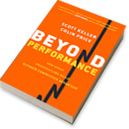
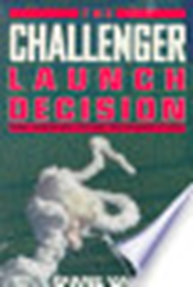
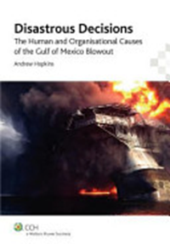
A healthy culture improves performance
Profit
Safety
Integrity
The Value of Corporate Culture
(2013, U of Chicago

Slide 5
Substantial Overlap
Profit
Safety
Ethics

Slide 6
The leadership imperative

Slide 7
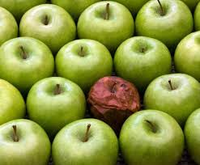
A healthy culture is one where
Doing the right thing is the expected practice every day, and actions that depart from the norms stands out and is addressed

Slide 8
Key Attributes of a Healthy Culture
Commitment
Clear Standards/ Norms
Values in Action
Account- ability
Open Commun-ications

Slide 9
Commitment
Organizational attributes
Mission and values reflect true commitment to doing the right thing
Balanced approach:
Performance AND Principles
Short term AND Long term
Shareholders AND Customers AND Employees
Compliance AND Innovation
Leadership attributes
Personal and professional commitment to mission, values, Code, doing the right thing
Personal integrity and respect
Authenticity
Commitment
Clear standards
Values in Action
Account-ability
Open commun-ications

Slide 10
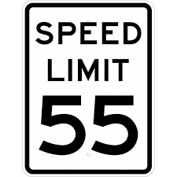
Clear Standards
Organizational attributes
Clear, consistent formal communications
Mission, vision, values
Code of Conduct
Policies
Communications and Training
Structures and incentives to align management communications
Leadership attributes
Talk the Talk—formal and informal, MBWA
Consistent, clear, honest messages on
Personal commitment and the organization’s
Expectations on performance and ethics/compliance
Business plans and performance
Evaluation of employee
Commitment
Clear standards
Values in Action
Account-ability
Open commun-ications

Slide 11
Values in Action
Organizational attributes
Respect
Fair process
Compassion
Courage
No conflicts of interest
Leadership attributes
Walk the Talk
Commitment
Clear standards
Values in Action
Account-ability
Open commun-ications

Slide 12
Accountability
Organizational attributes
Performance and principles built into HR systems
Fair processes
Consistent disciplinary approach for all
Leadership attributes
Hold others and themselves accountable
Vigilance
Responsiveness
+
Commitment
Clear standards
Values in Action
Account-ability
Open commun-ications
Values
-
-
Performance
+

Slide 13
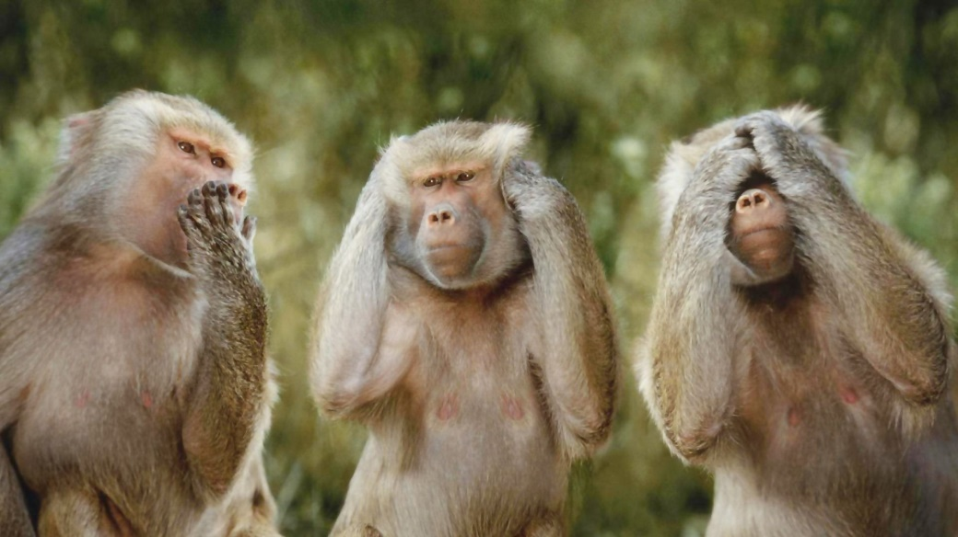
Open Communications
Organizational attributes
Core practice up, across and down
Anti-retaliation policies effective
Alternative reporting channels available and trusted
Leadership attributes
Be accessible
Listen with an open mind
Do not retaliate
Respond appropriately
Commitment
Clear standards
Values in Action
Account-ability
Open commun-ications

Slide 14
Improving a culture

Slide 15
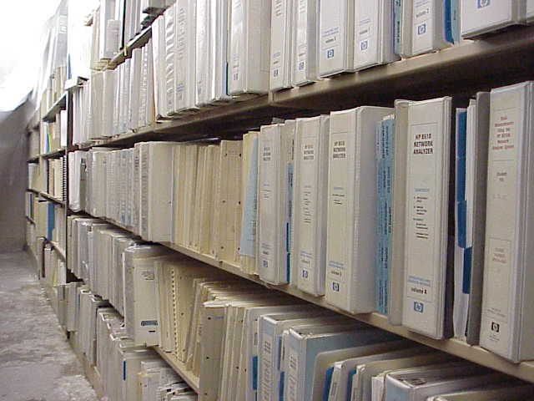
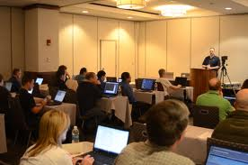
Tried and failed
Safety
+
Integrity

Slide 16
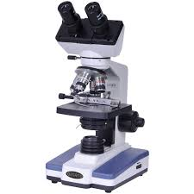
Know your culture
Observable negative actions
Reports and concerns
Reports from Audit, HR, Security
Employee perceptions
Perceptions of suppliers, customers
Remember Albert Einstein:
“Not everything that can be counted counts, and not everything that counts can be counted.”

Slide 17
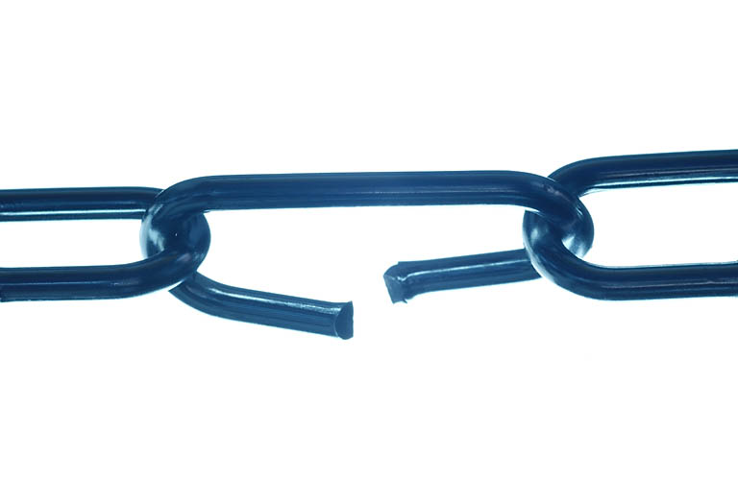
What is your weakest link?
Commitment
Clear standards/Talk the talk
Values in Action/Walk the talk
Accountability
Open Communications/Listen and Learn
Commitment
Talk the Talk
Walk the Talk
Hold Accountable
Listen & Learn

Slide 18
Shaping a culture
Big change requires partners
Senior management
Human Resources
Legal
Finance/Audit
Communications
E&C can nudge the culture
Training emphasizing key cultural attributes
Marketing/ communications/Code
Conspire with HR
Performance appraisal
Coaching
Disciplinary processes

Slide 19
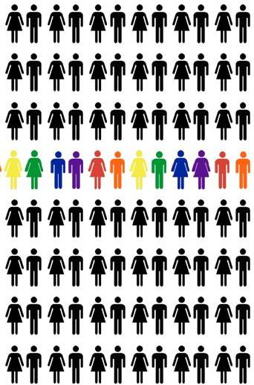
Target your efforts
And their supervisors & managers

Slide 20
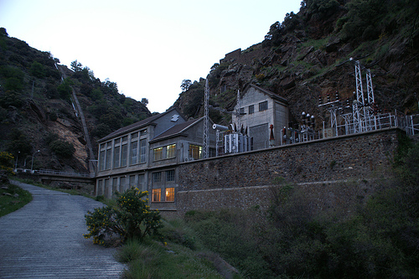

Slide 21
For more information:
Steve Priest Integrity Insight International, llc ethical@aol.com

